Slide 1
Graphical User Interfaces with Windows Forms: Part 1
Chapter 14 of Visual C# How to Program, 6/e

Slide 2
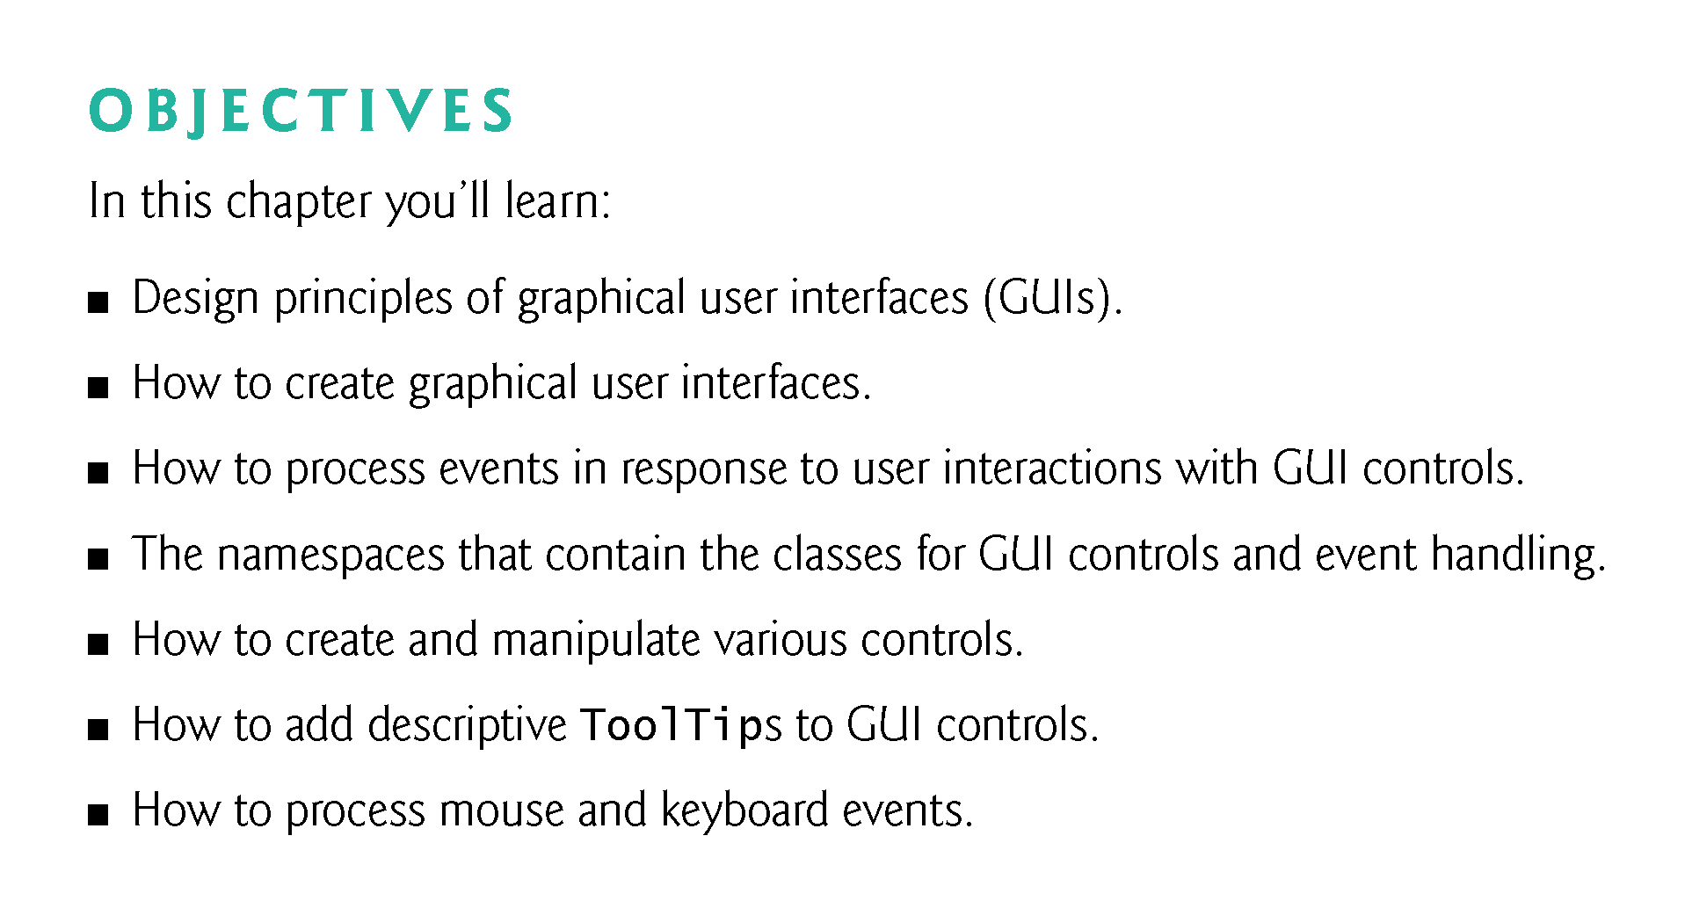

Slide 3
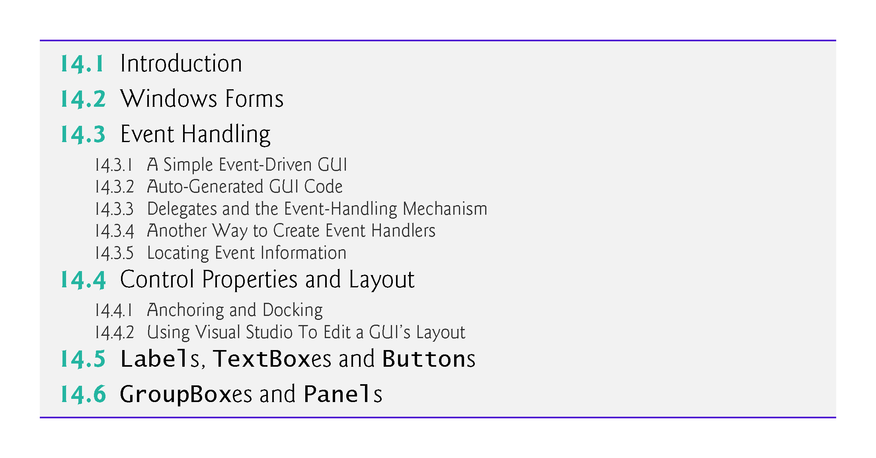

Slide 4
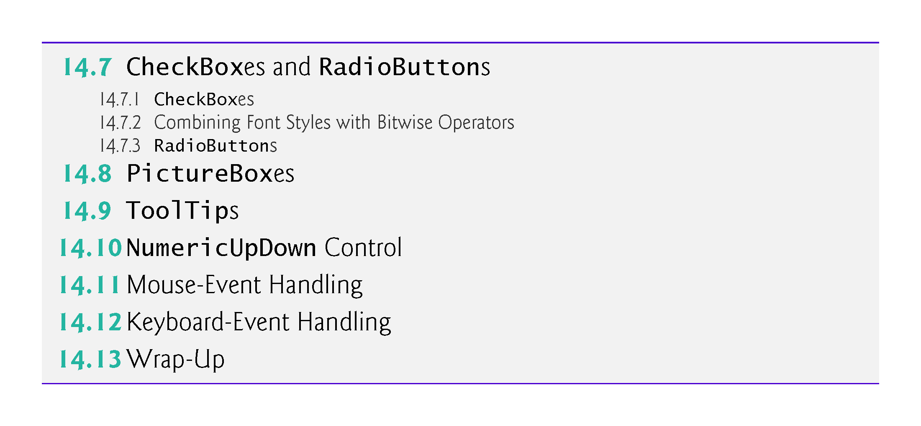

Slide 5
14.1 Introduction
A graphical user interface (GUI) allows a user to interact visually with a program.
Figure 14.1 shows a Visual Studio window containing various GUI controls.

Slide 6
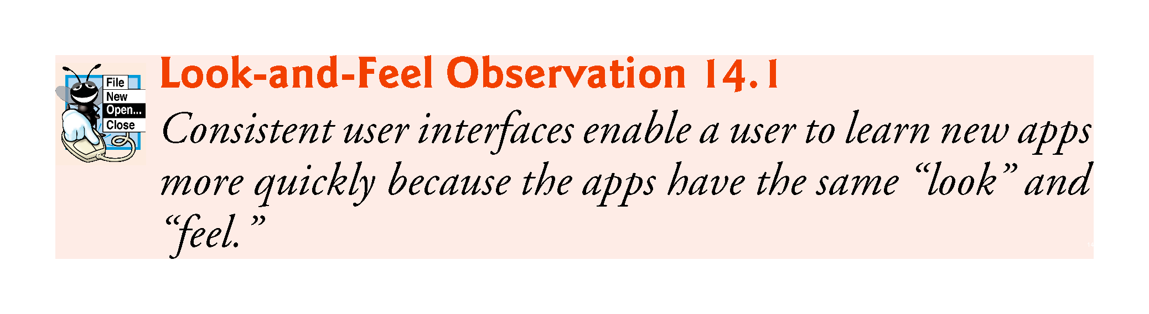

Slide 7
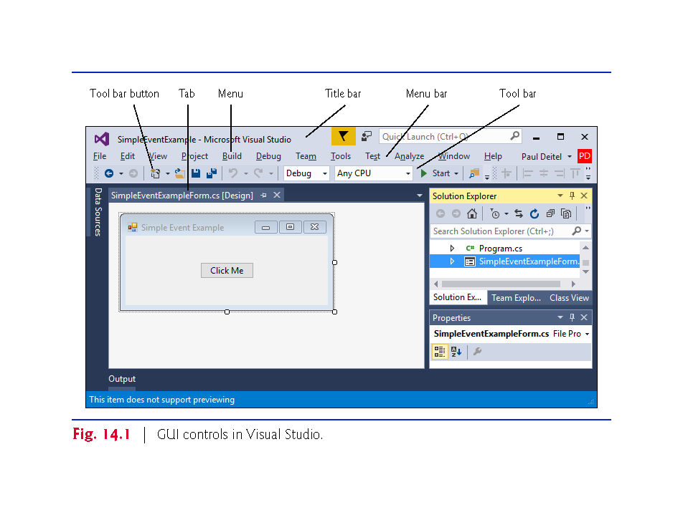

Slide 8
14.1 Introduction (Cont.)
GUI controls are objects that can display information on the screen or enable users to interact with an app.
Several common GUI controls are listed in Fig. 14.2.

Slide 9
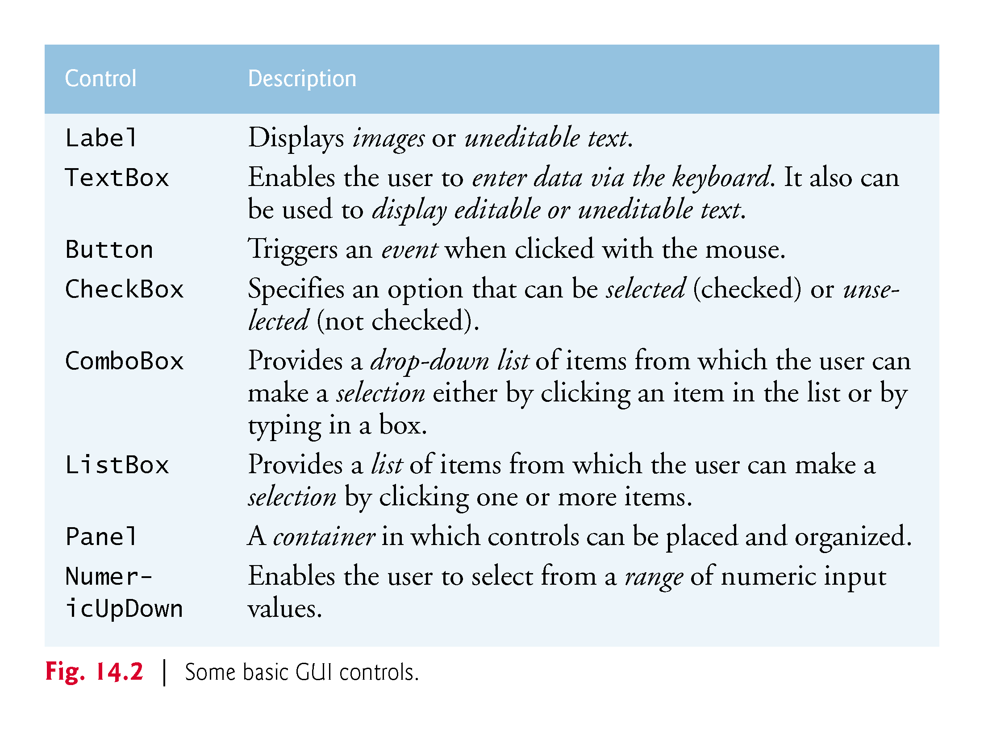

Slide 10
14.2 Windows Forms
A Form is a graphical element that appears on your computer’s desktop; it can be a dialog, a window or an MDI window.
A component is an instance of a class that implements the IComponent interface, which defines the behaviors that components must implement, such as how the component is loaded.
A control, such as a Button or Label, has a graphical representation at runtime.

Slide 11
14.2 Windows Forms (Cont.)
Figure 14.3 displays the Windows Forms controls and components from the C# Toolbox.
To add a control or component, select it from the Toolbox and drag it onto the Form.

Slide 12
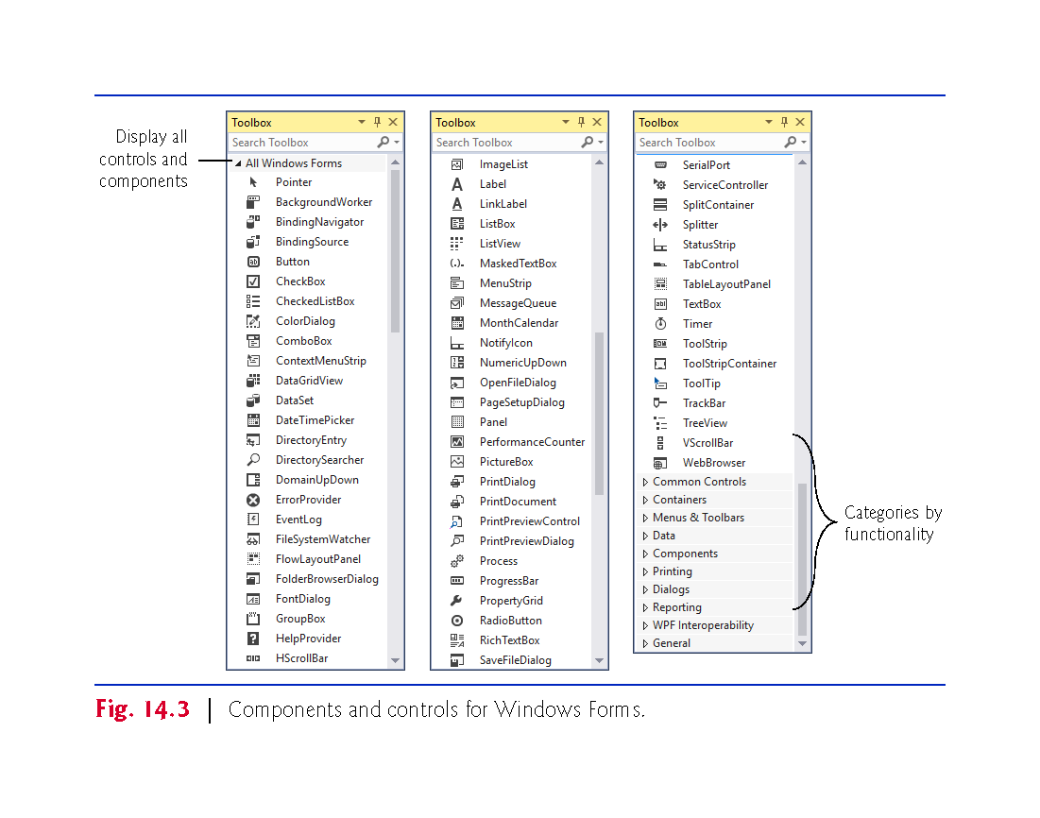

Slide 13
14.2 Windows Forms (Cont.)
The active window is the frontmost and has a highlighted title bar.
A window becomes the active window when the user clicks somewhere inside it.
A Form is a container for controls and components.
When you drag items from the Toolbox onto the Form, Visual Studio generates code that creates the object and sets its basic properties.
The IDE maintains the generated code in a separate file using partial classes.

Slide 14
14.2 Windows Forms (Cont.)
Figure 14.4 lists common Form properties, common methods and a common event.

Slide 15
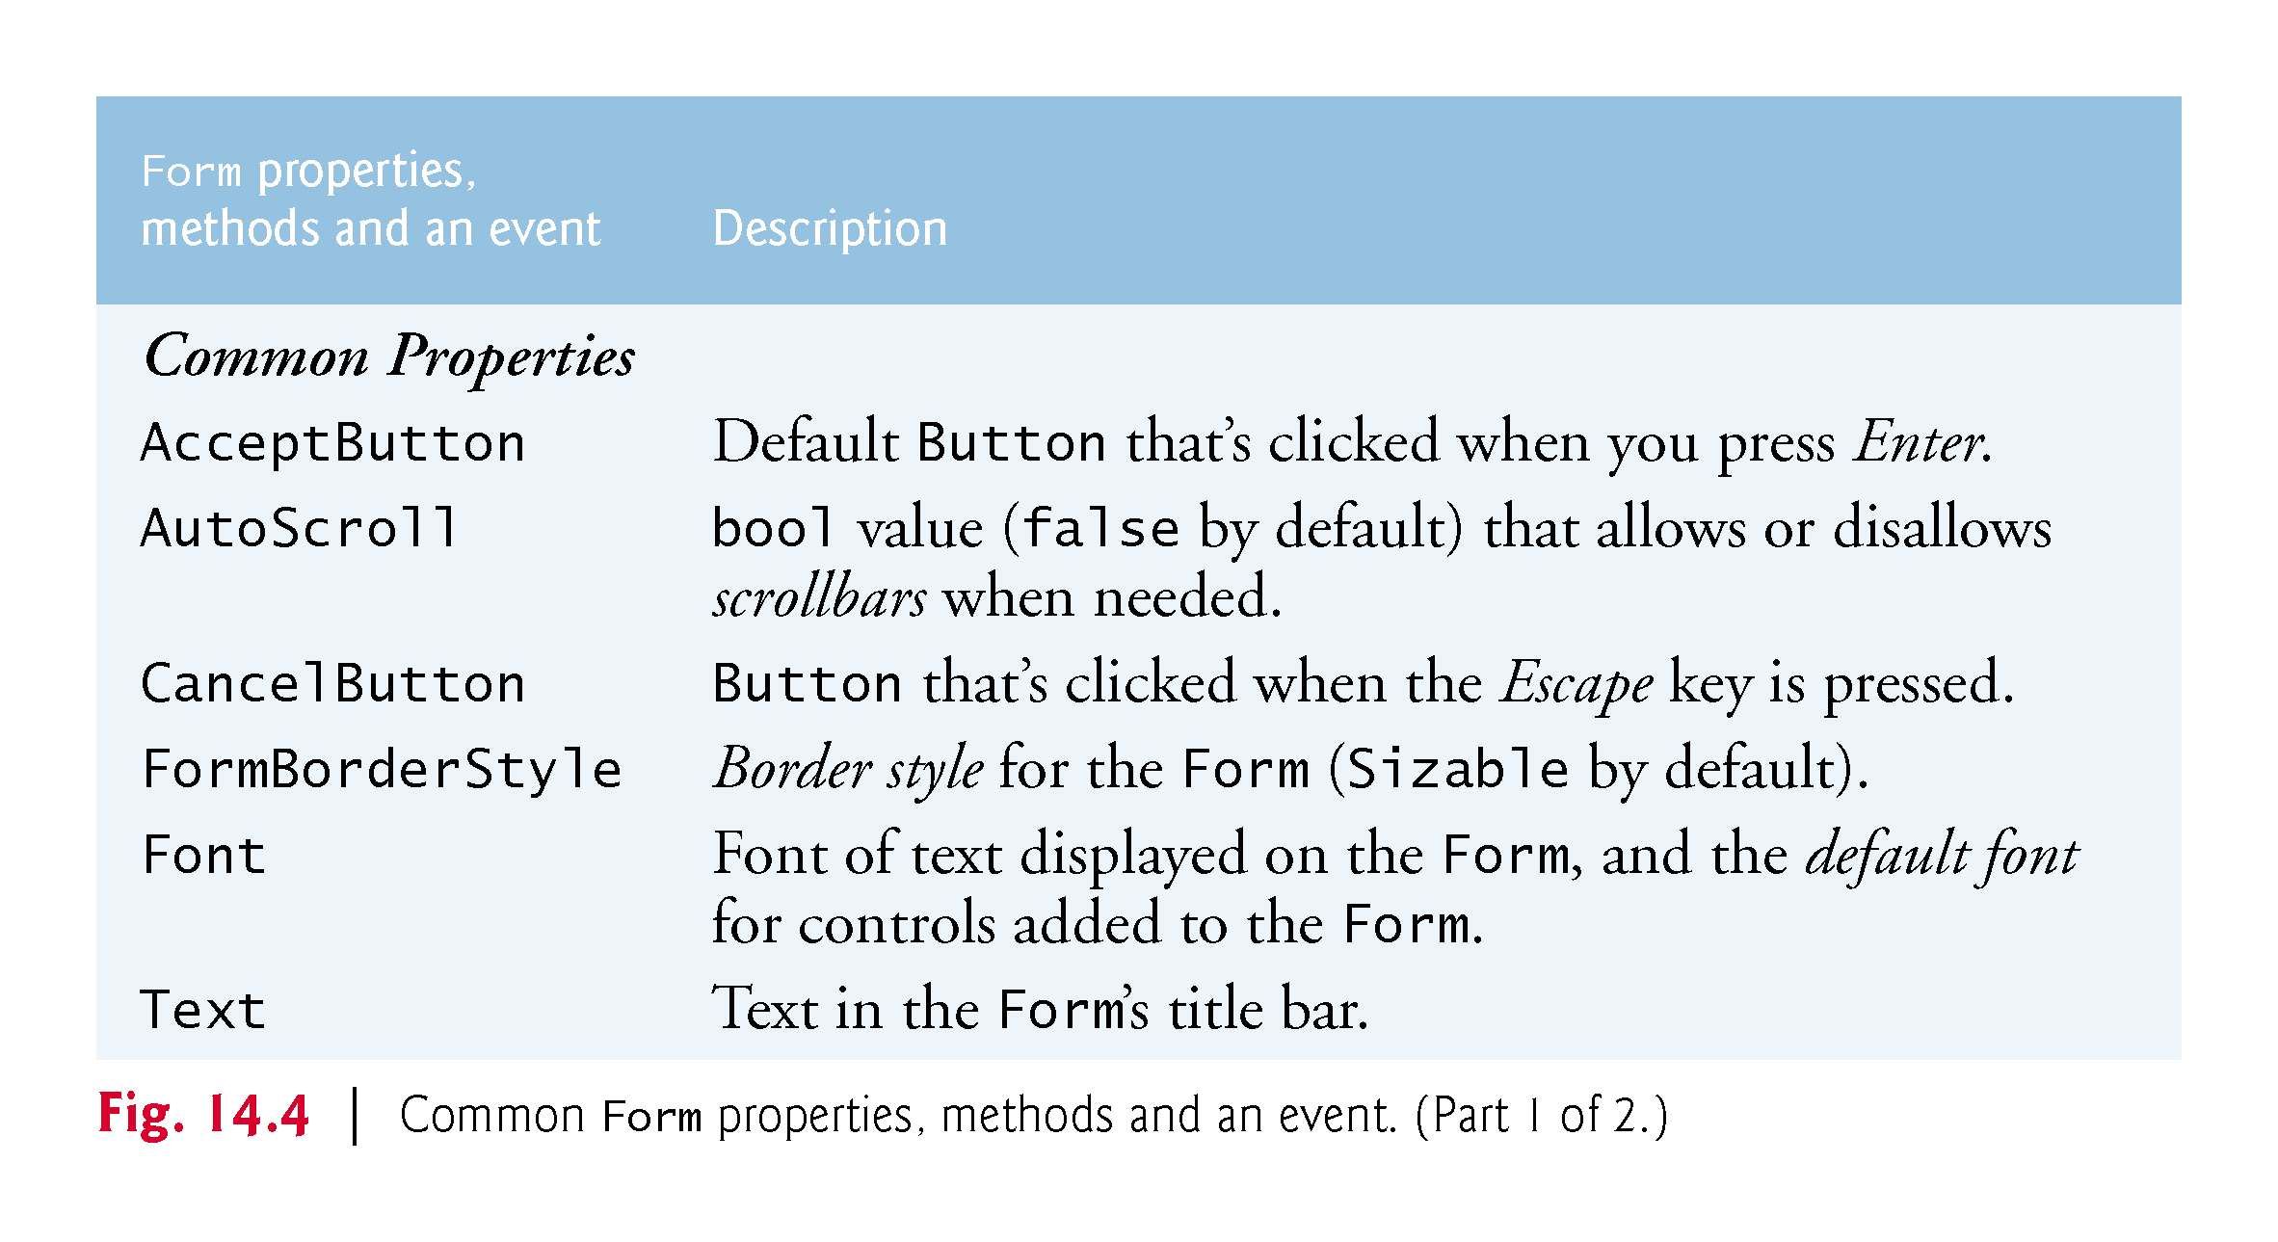

Slide 16
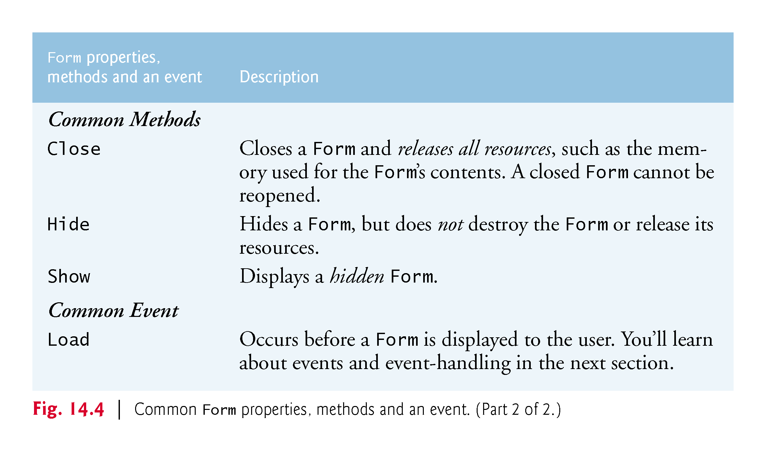

Slide 17
14.3 Event Handling
GUIs are event driven.
When the user interacts with a GUI component, the event drives the program to perform a task.
A method that performs a task in response to an event is called an event handler.

Slide 18
14.3 Event Handling
14.3.1 A Simple Event-Driven GUI
The Form in the app of Fig. 14.5 contains a Button that a user can click to display a MessageBox.

Slide 19
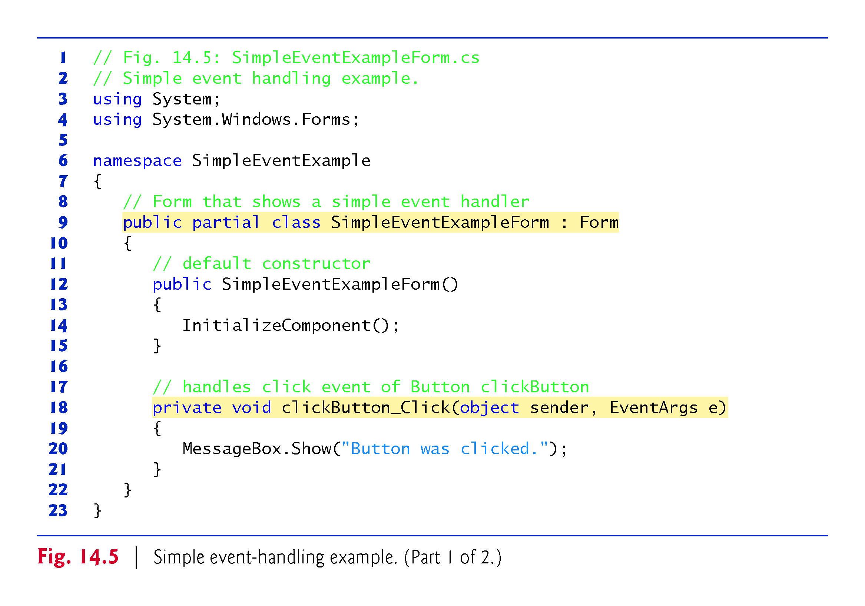

Slide 20
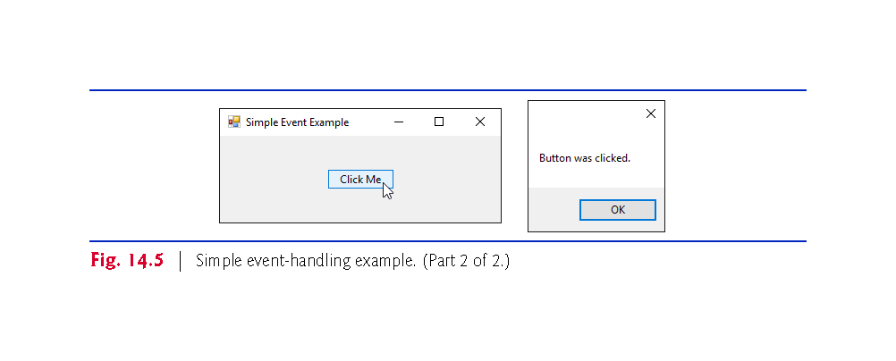

Slide 21
14.3 Event Handling
Adding an Event Handler for the Button’s Click Event
To create the app’s event handler, double click the Button on the Form.
The following empty event handler is declared:
private void clickButton_Click (object sender, EventArgs e) { }
By convention, the IDE names the event-handler method as objectName_eventName (e.g., clickButton_Click).

Slide 22
14.3 Event Handling (Cont.)
Event Handler Parameters
Each event handler receives two parameters when it’s called:
This first—an object reference typically named sender—is a reference to the object that generated the event.
The second is a reference to an EventArgs object (or an object of an EventArgs derived class) which contains additional information about the event.

Slide 23
14.3 Event Handling (Cont.)
14.3.2 Auto-Generated GUI Code
Visual Studio places the auto-generated code in the Designer.cs file of the Form.
Open this file by expanding the node in the Solution Explorer window for the file you’re currently working in (SimpleEventExampleForm.cs) and double clicking the file name that ends with Designer.cs.
Since this code (Figs. 14.6 and 14.7) is created and maintained by Visual Studio, you generally don’t need to look at it.

Slide 24
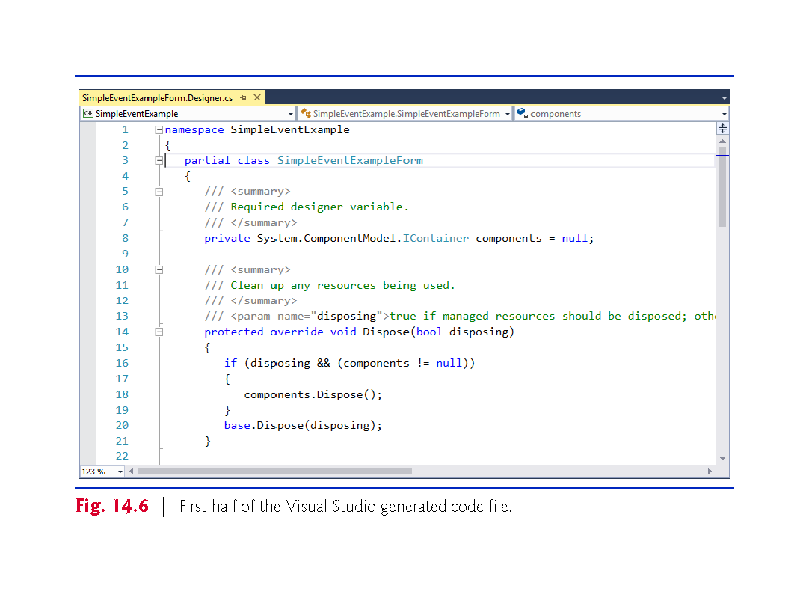

Slide 25
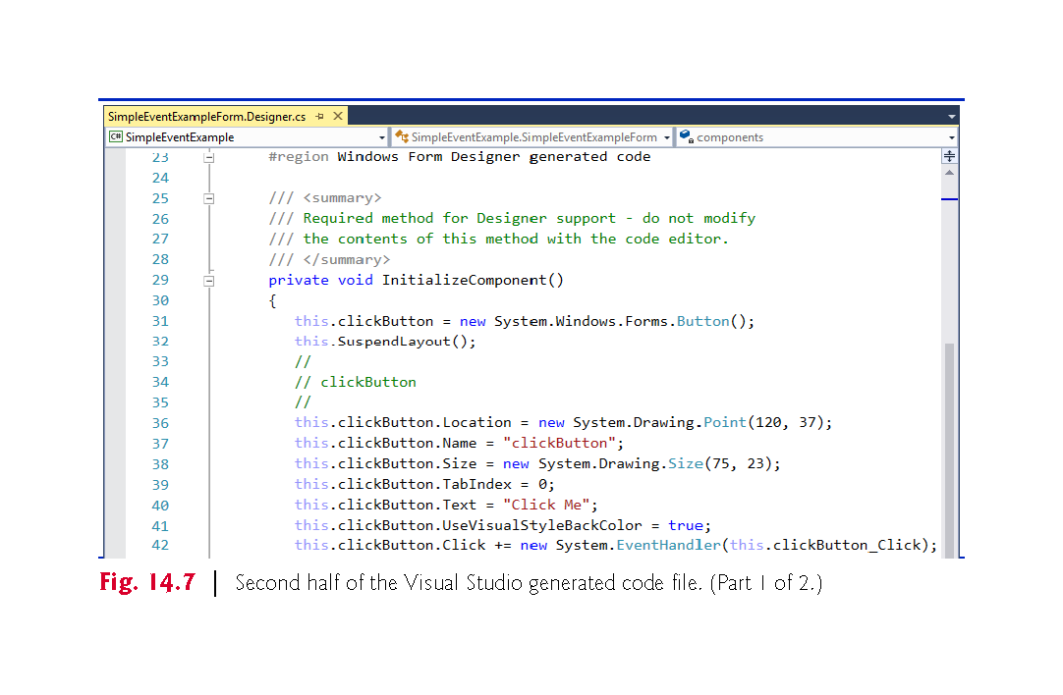

Slide 26
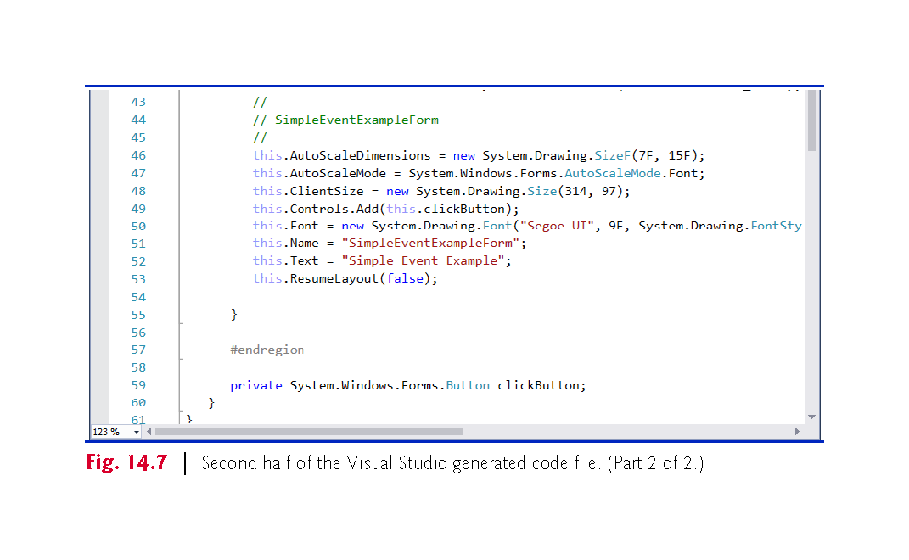

Slide 27
14.3 Event Handling (Cont.)
The partial modifier allows the Form’s class to be split among multiple files.
Fig. 14.7 declares the clickButton that we created in Design mode. It’s declared as an instance variable of class SimpleEventExampleForm.
The property values correspond to the values set in the Properties window for each control.
Method InitializeComponent is called when the Form is created.

Slide 28
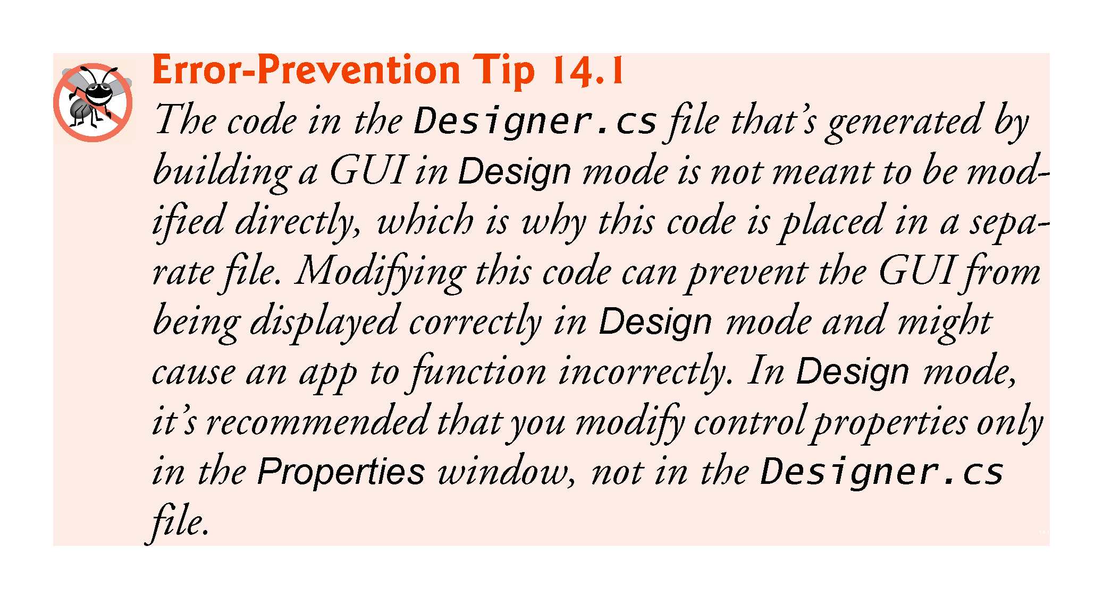

Slide 29
14.3 Event Handling (Cont.)
14.3.3 Delegates and the Event-Handling Mechanism
Event handlers are connected to a control’s events via special objects called delegates.
A delegate type declaration specifies the signature of a method—in event handling, the signature specifies the return type and arguments for an event handler.
A delegate of type EventHandler can hold references to methods that return void and receive two parameters—one of type object and one of type EventArgs:
public delegate void EventHandler(object sender, EventArgs e);

Slide 30
14.3 Event Handling (Cont.)
Indicating the Method that a Delegate Should Call
A Button calls its EventHandler delegate in response to a click.
The delegate’s job is to invoke the appropriate method.
This code is added by Visual Studio when you double click the Button control in Design mode:
new System.EventHandler(this.clickButton_Click);
Adding more delegates to an event is called multicast delegates.

Slide 31
14.3 Event Handling (Cont.)
14.3.4 Another Way to Create Event Handlers
Using the Properties Window to Create Event Handlers
Controls can generate many different events.
Clicking the Events icon (the lightning-bolt icon) in the Properties window (Fig. 14.8), displays all the events for the selected control.

Slide 32
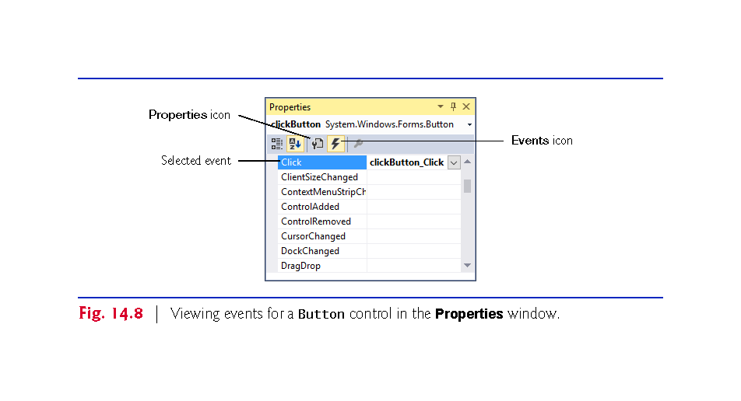

Slide 33
14.3 Event Handling (Cont.)
14.3.5 Locating Event Information
Read the Visual Studio documentation to learn about the different events raised by each control.
To do this, select a control in the IDE and press the F1 key to display that control’s online help (Fig. 14.9).
The web page that's displayed contains basic information about the control’s class.

Slide 34
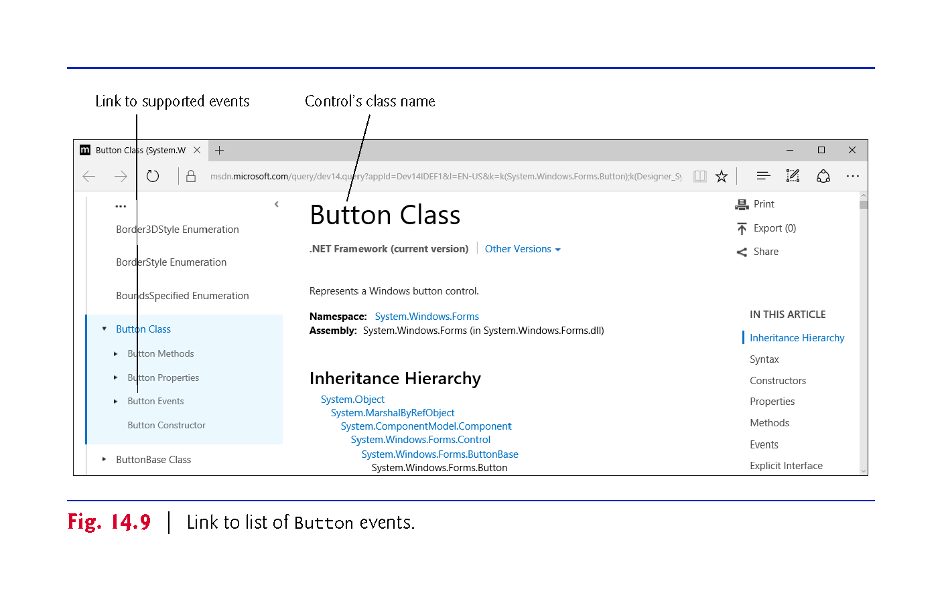

Slide 35
14.3 Event Handling (Cont.)
Click the name of an event to view its description and examples of its use.
We selected the Click event to display the information in Fig. 14.10.

Slide 36
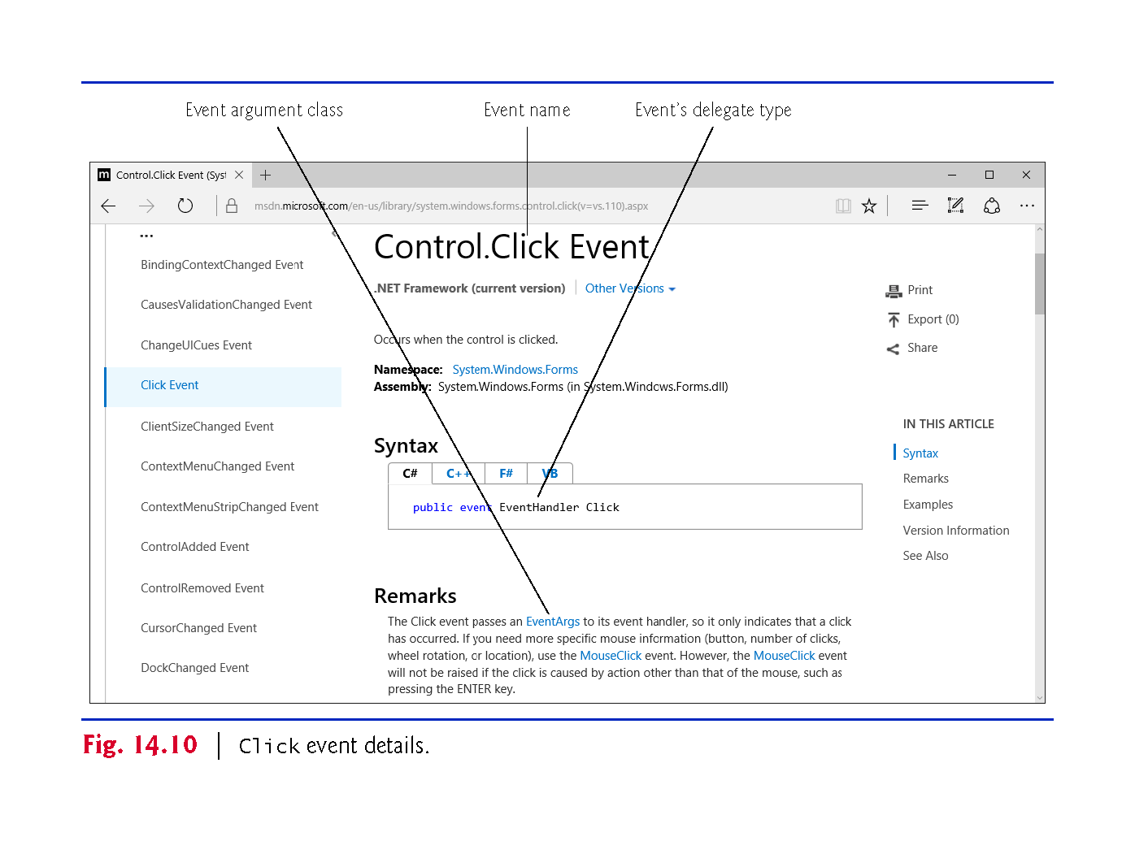

Slide 37
14.4 Control Properties and Layout
Controls derive from class Control (namespace System.Windows.Forms).
Figure 14.11 lists some of class Control’s properties and methods.

Slide 38
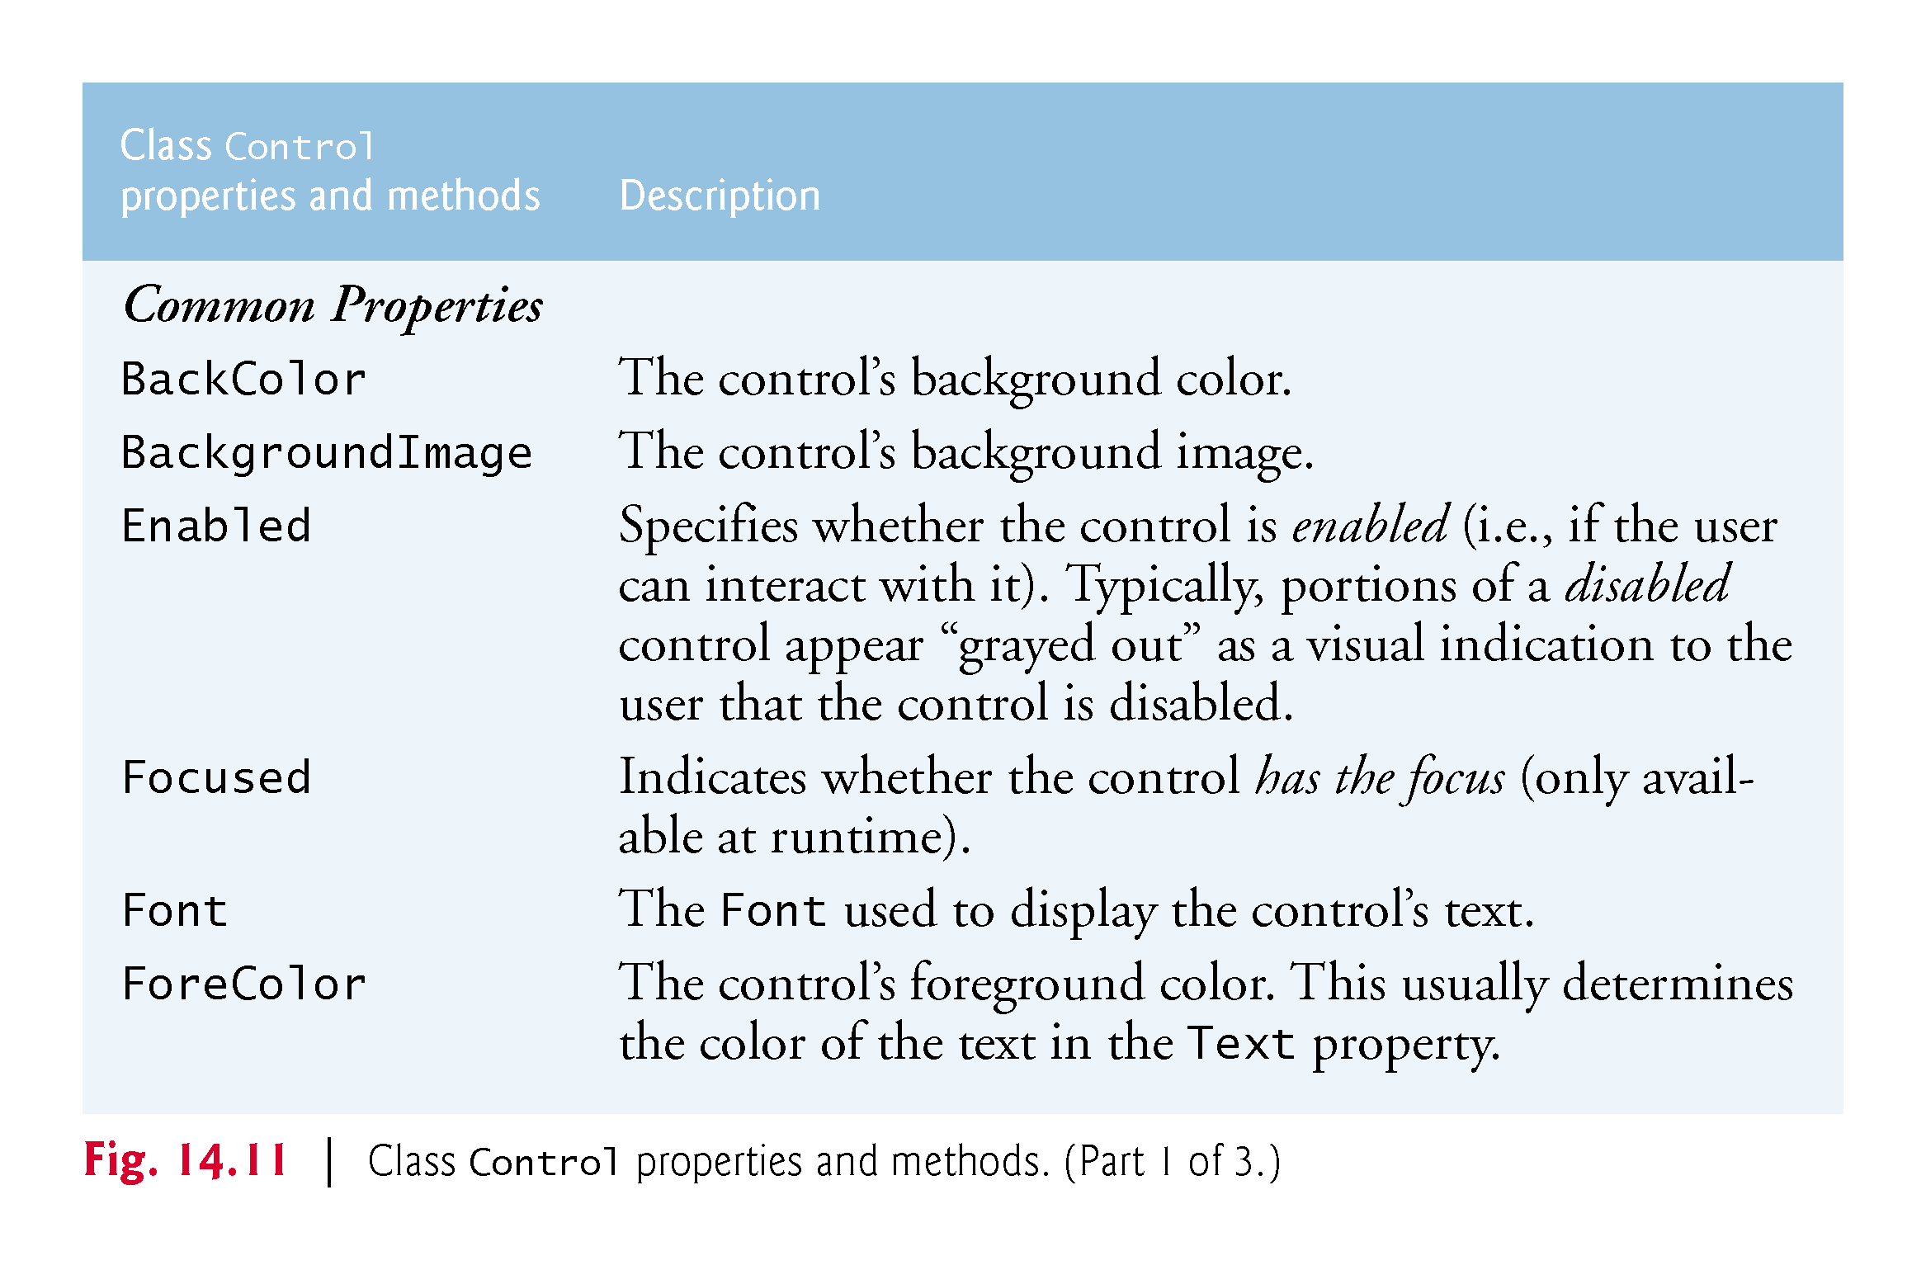

Slide 39
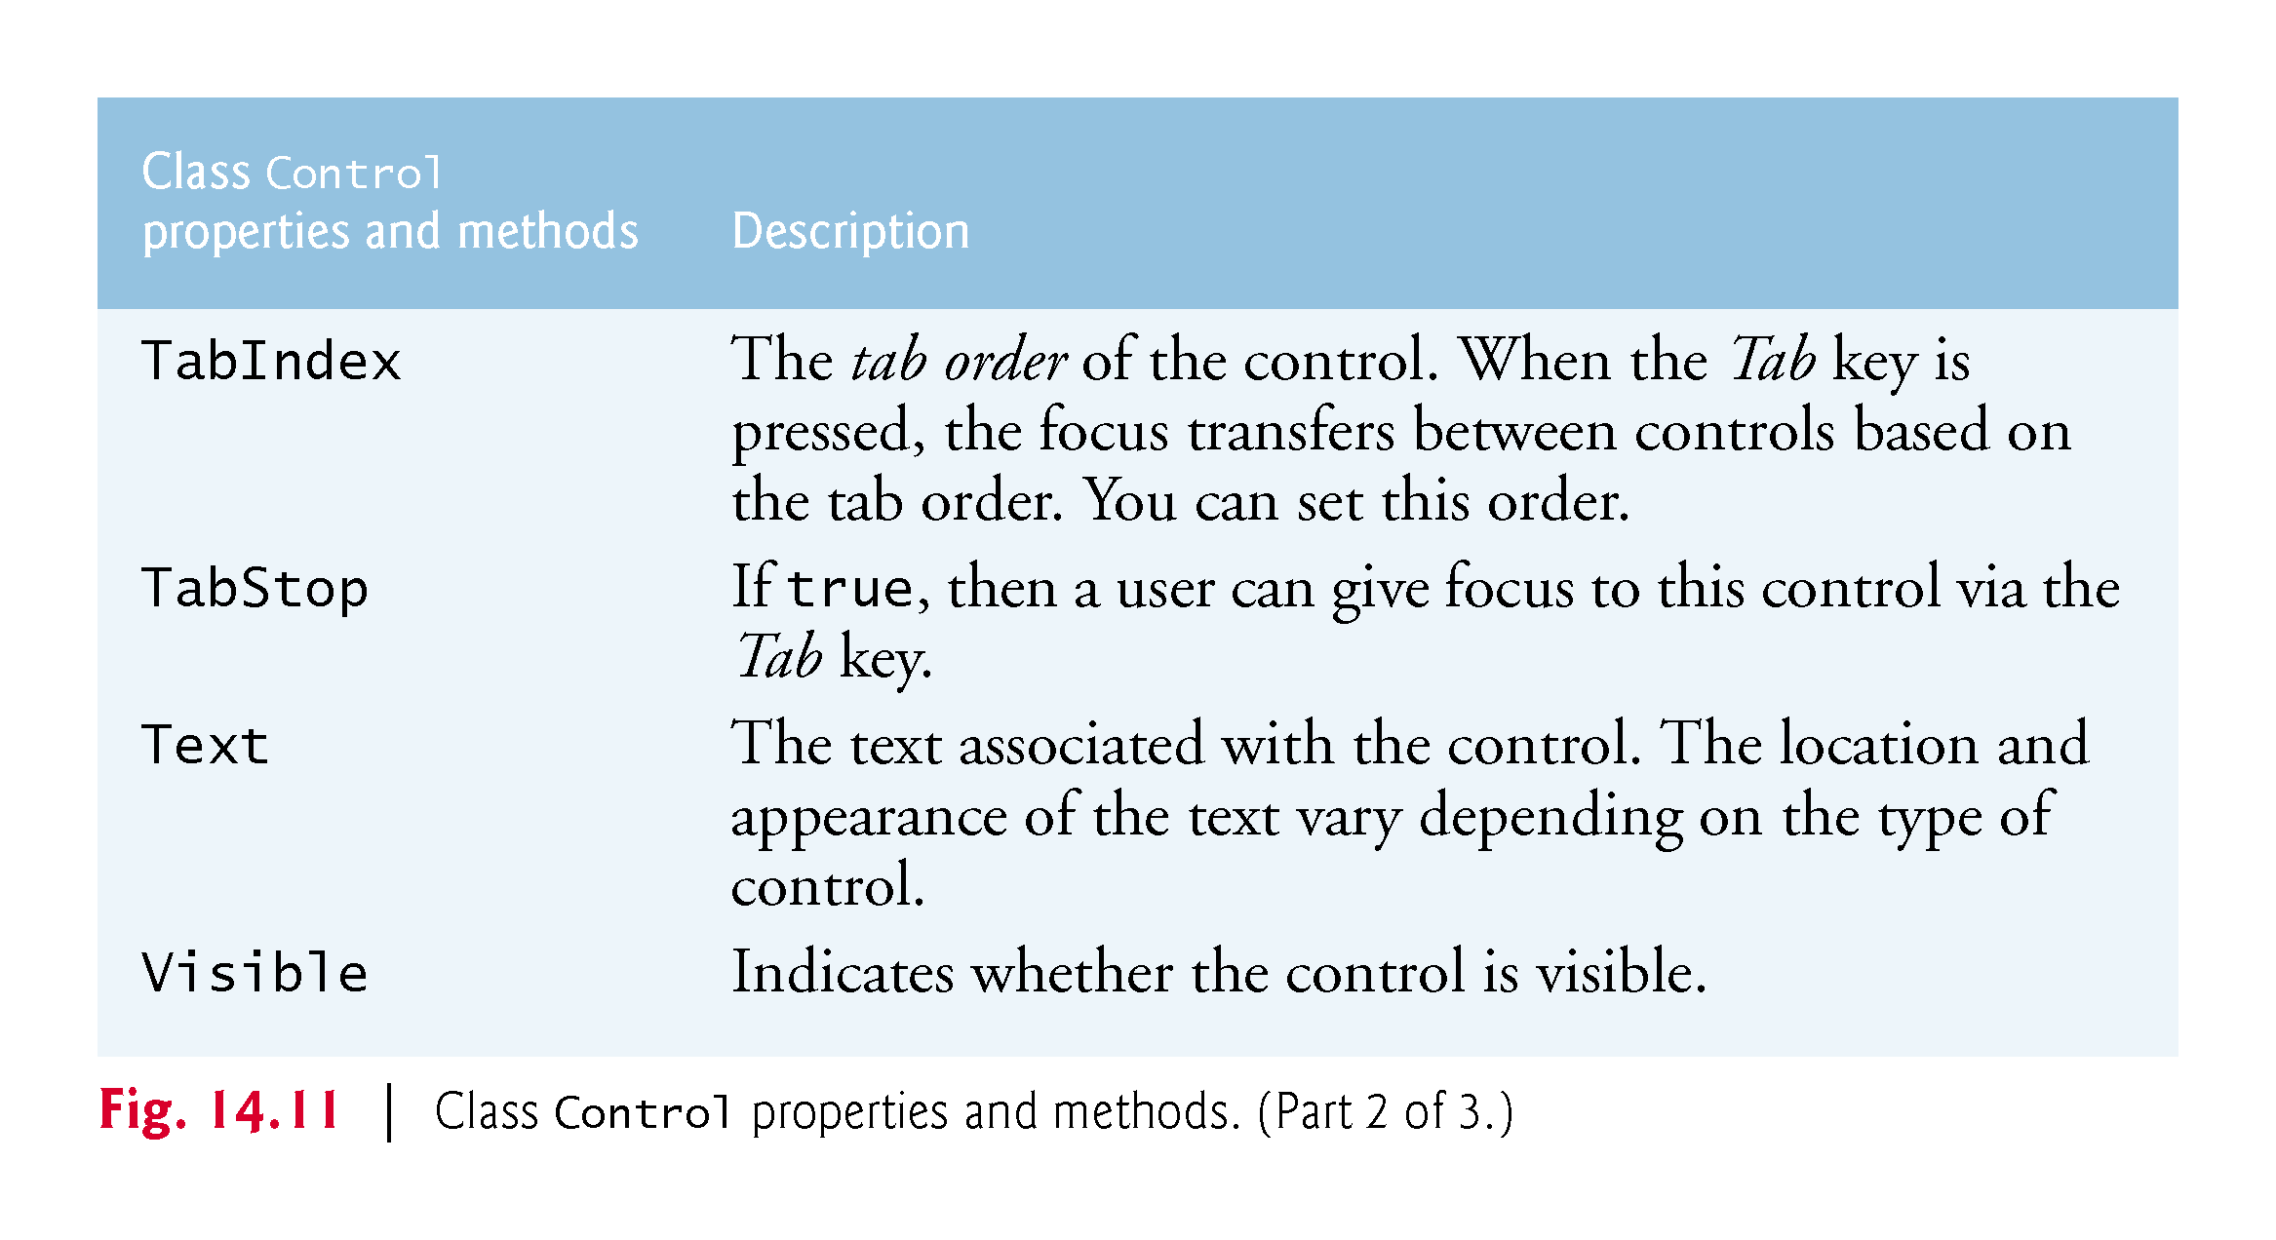

Slide 40
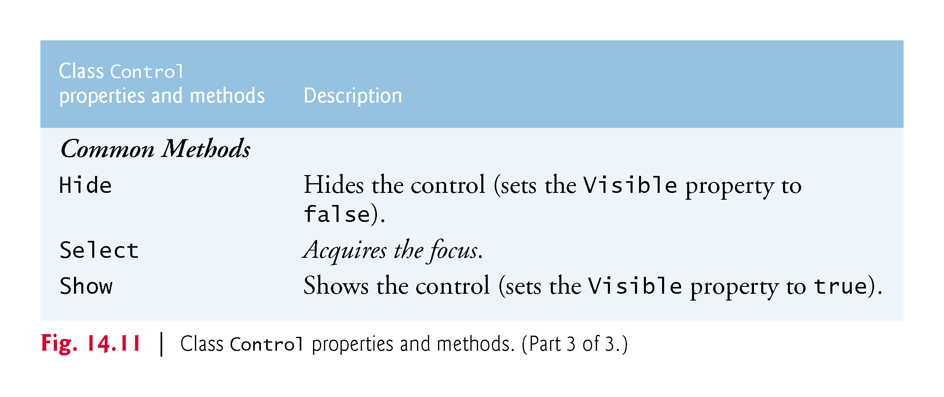

Slide 41
14.4 Control Properties and Layout (Cont.)
Anchoring and Docking
Anchoring causes controls to remain at a fixed distance from the sides of the container.
Anchor a control to the right and bottom sides by setting the Anchor property (Fig. 14.12).

Slide 42
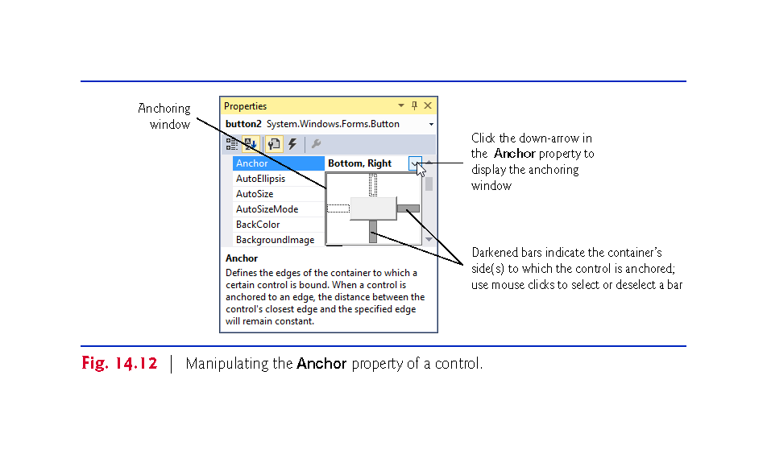

Slide 43
14.4 Control Properties and Layout (Cont.)
Execute the app and enlarge the Form (Fig. 14.13).

Slide 44
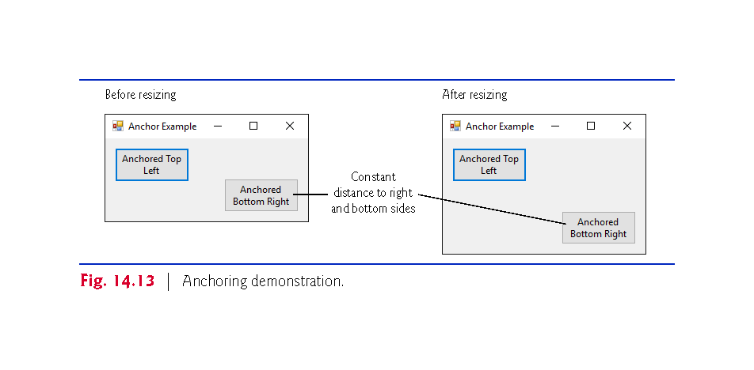

Slide 45
14.4 Control Properties and Layout (Cont.)
Docking attaches a control to a container such that the control stretches across an entire side or fills an entire area.
Docking allows a control to span an entire side of its parent container or to fill the entire container (Fig. 14.14).
The Form’s Padding property specifies the distance between the docked controls and the edges.

Slide 46
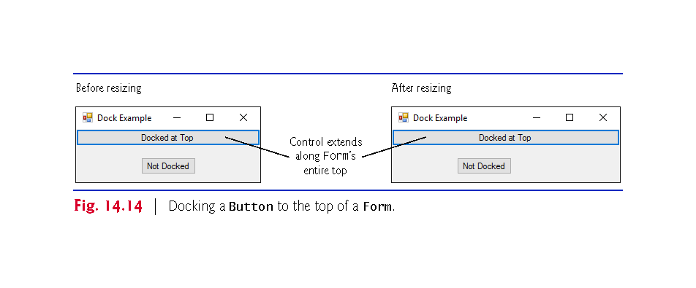

Slide 47
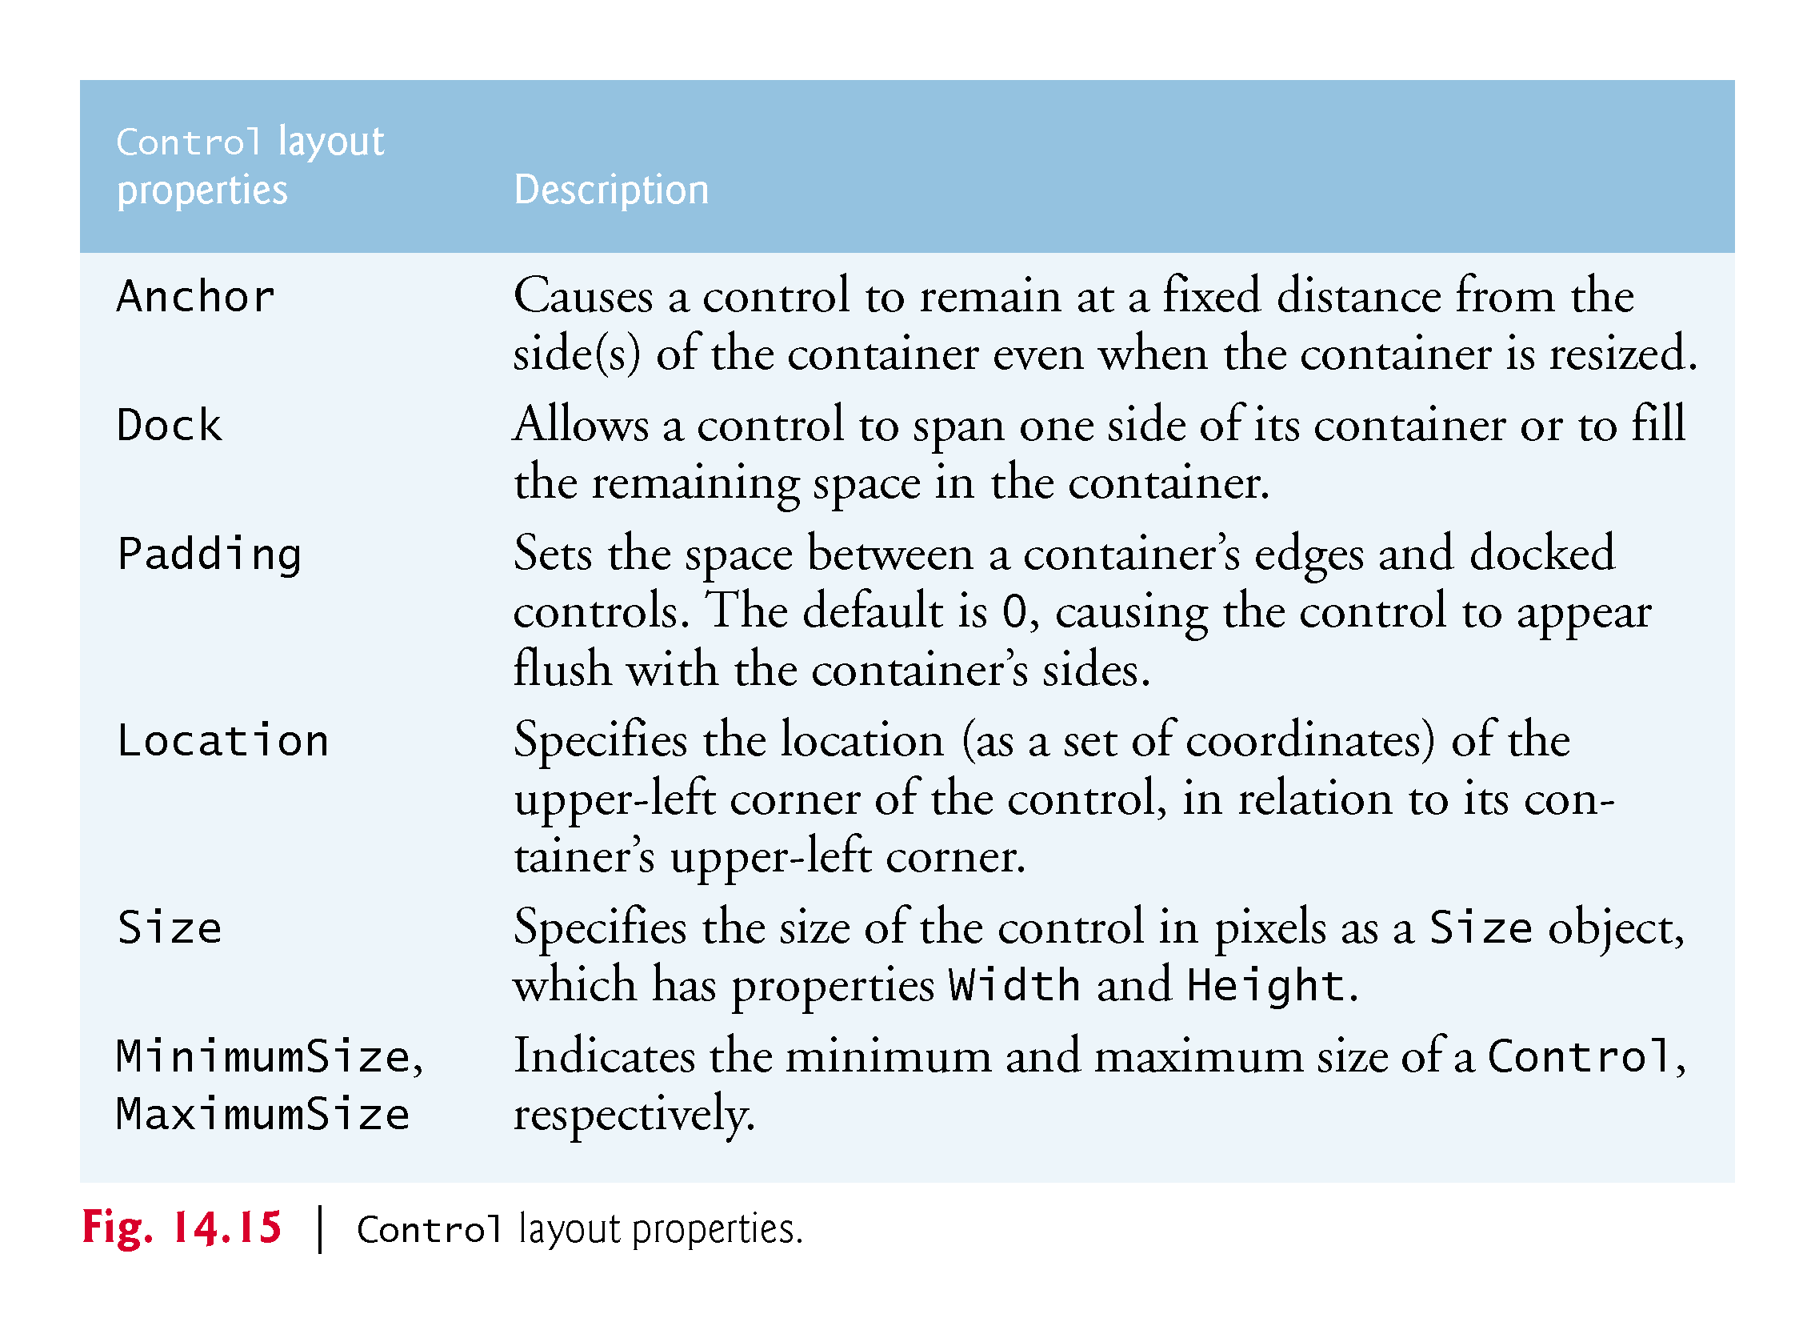

Slide 48
14.4 Control Properties and Layout (Cont.)
Using Visual Studio To Edit a GUI’s Layout
Visual Studio provides tools that help you with GUI layout.
When dragging a control across a Form, blue lines (known as snap lines) help you position the control (Fig. 14.16).
Visual Studio also provides the Format menu, which contains several options for modifying your GUI’s layout.

Slide 49
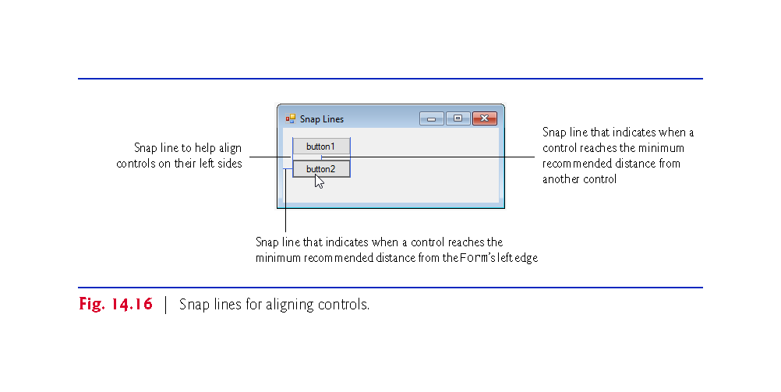

Slide 50
14.5 Labels, TextBoxes and Buttons
Labels display text that the user cannot directly modify.
Figure 14.7 lists common Label properties.

Slide 51
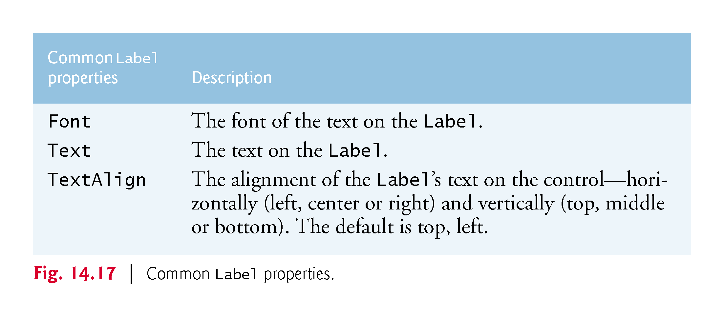

Slide 52
14.5 Labels, TextBoxes and Buttons (Cont.)
A TextBox (Fig. 14.18) is an area in which either text can be displayed by a program or the user can type text via the keyboard.
If you set the property UseSystemPasswordChar to true, the TextBox becomes a password TextBox.

Slide 53
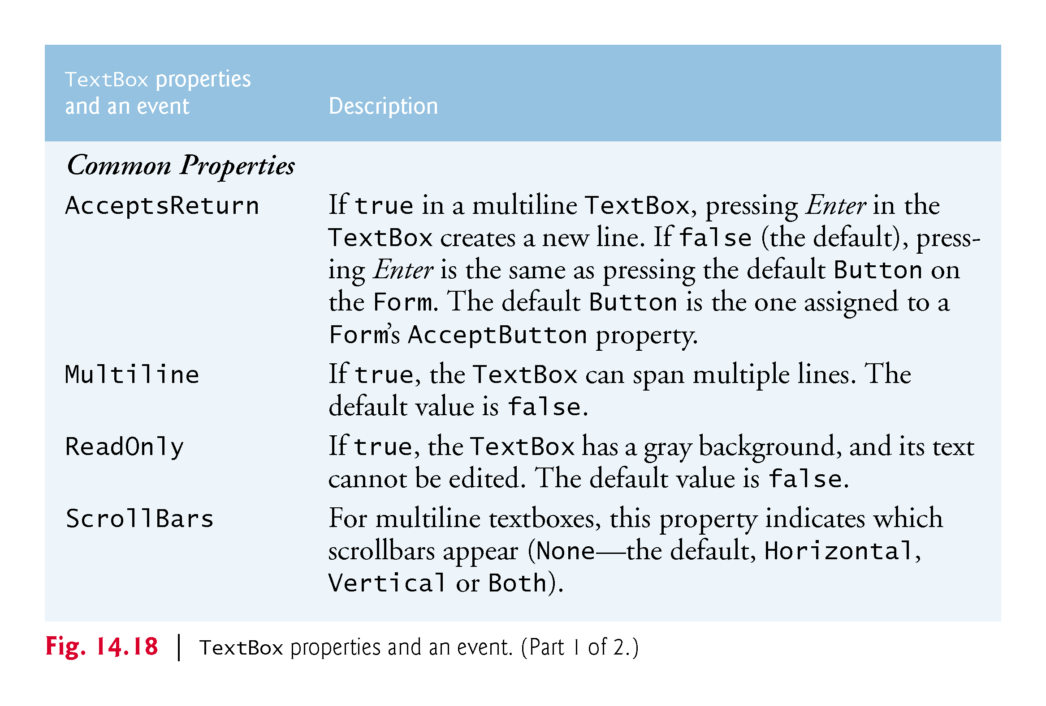

Slide 54
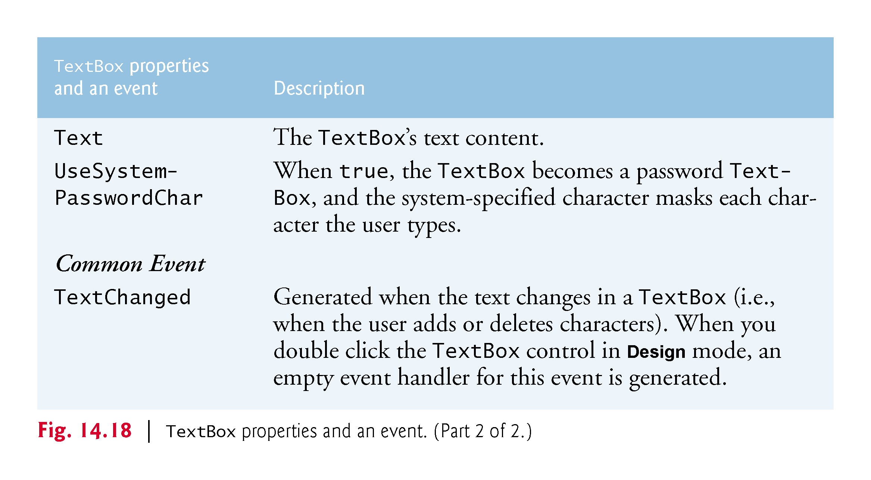

Slide 55
14.5 Labels, TextBoxes and Buttons (Cont.)
A button is a control that the user clicks to trigger a specific action or to select an option in a program.
A program can use several types of buttons, but all the button classes derive from class ButtonBase.

Slide 56
14.5 Labels, TextBoxes and Buttons (Cont.)
Figure 14.19 lists common properties and a common eventof class Button.

Slide 57
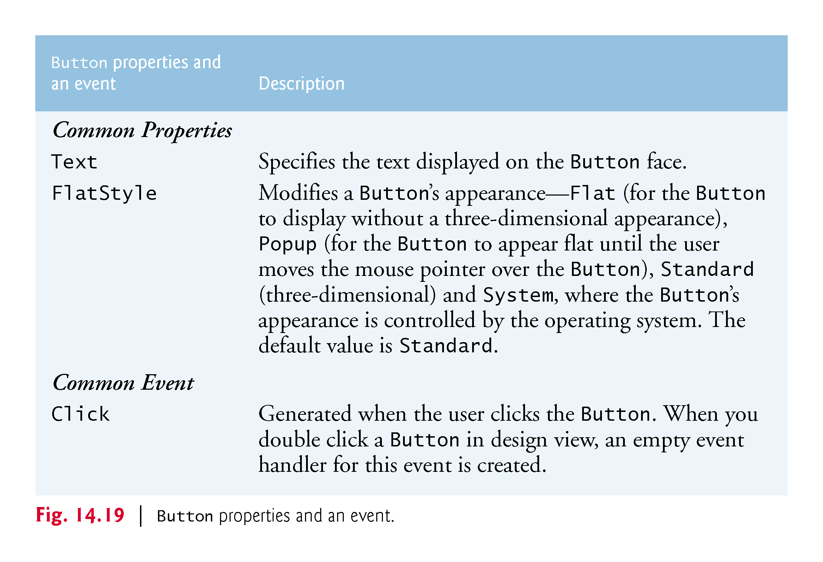

Slide 58
14.5 Labels, TextBoxes and Buttons (Cont.)
Figure 14.20 uses a TextBox, a Button and a Label.

Slide 59
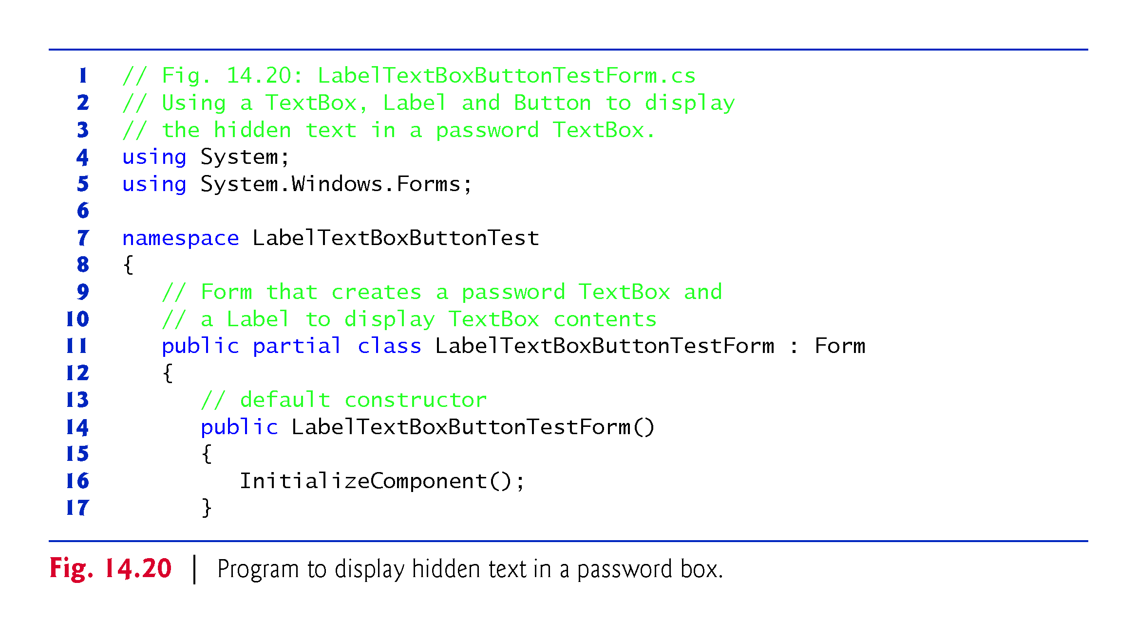

Slide 60
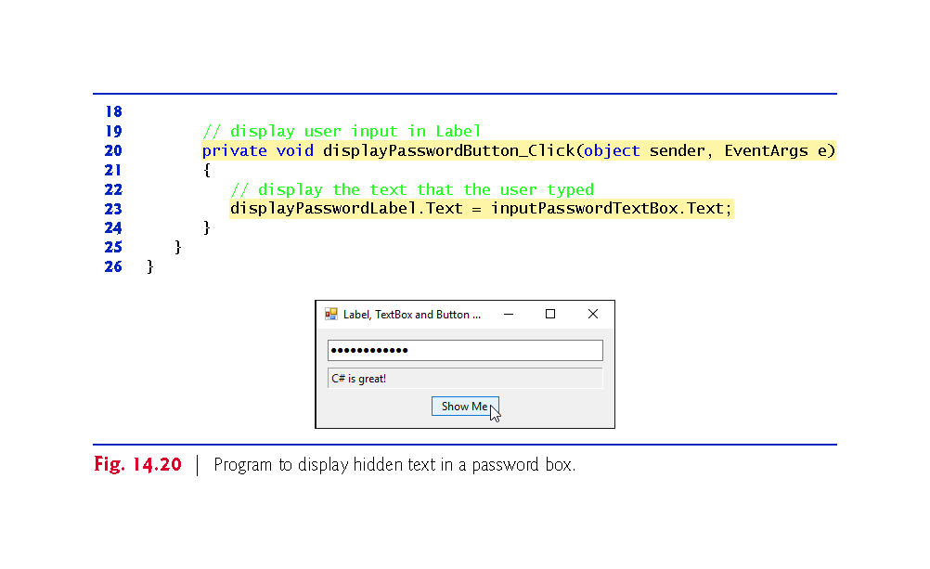

Slide 61
14.6 GroupBoxes and Panels
GroupBoxes and Panels arrange related controls on a GUI.
All of the controls in a GroupBox or Panel move together when the GroupBox or Panel is moved.
The primary difference is that GroupBoxes can display a caption and do not include scrollbars, whereas Panels can include scrollbars and do not include a caption.

Slide 62
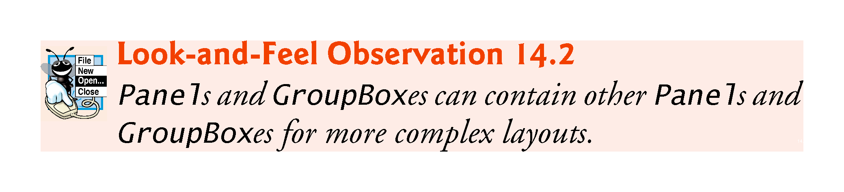

Slide 63
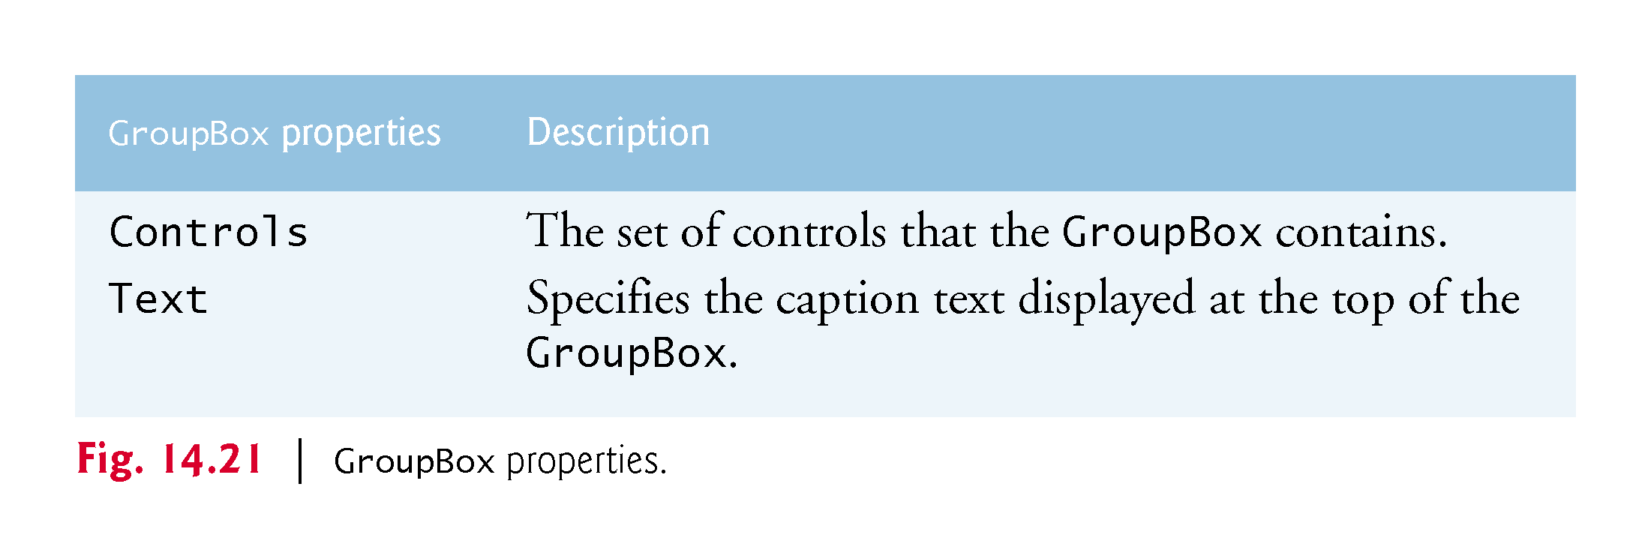

Slide 64
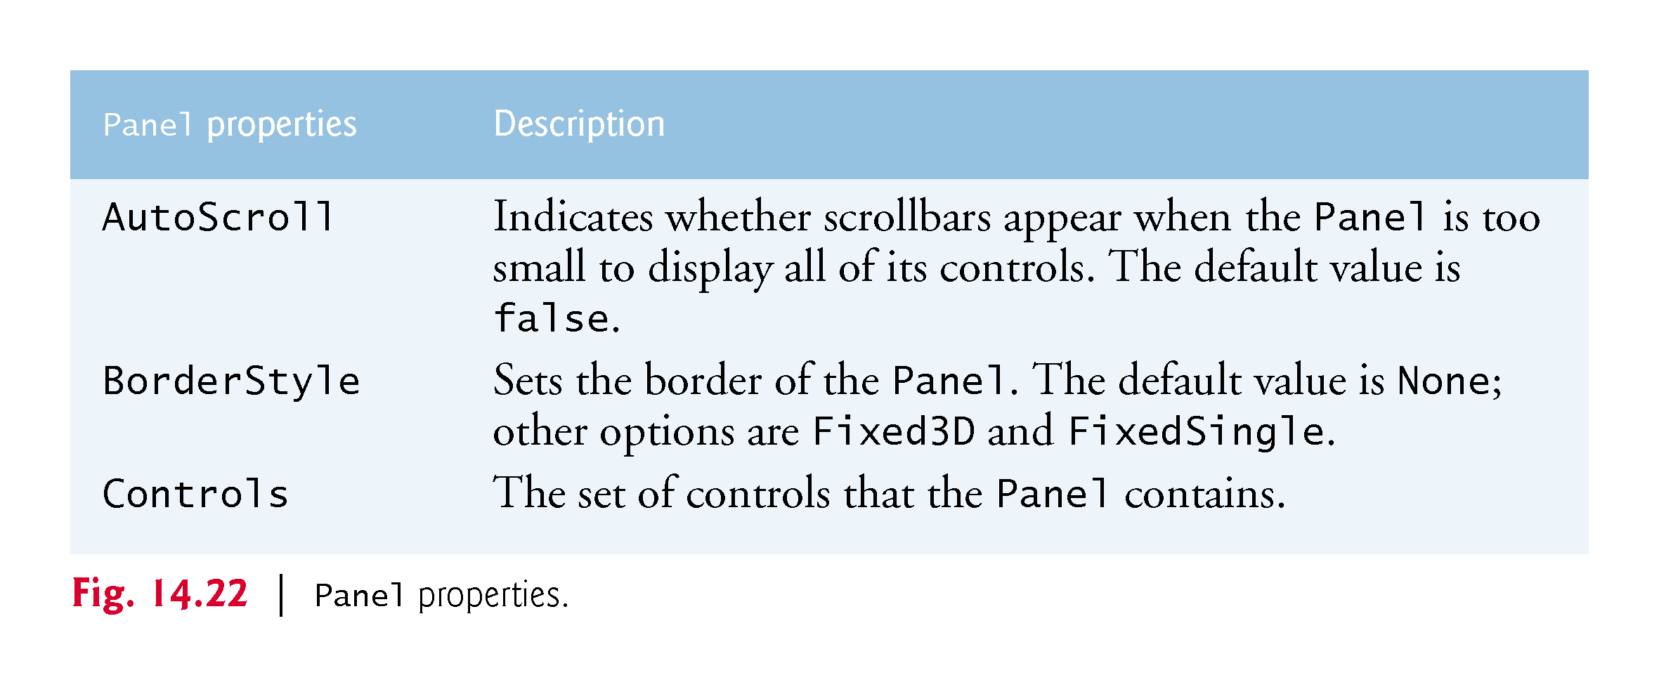

Slide 65
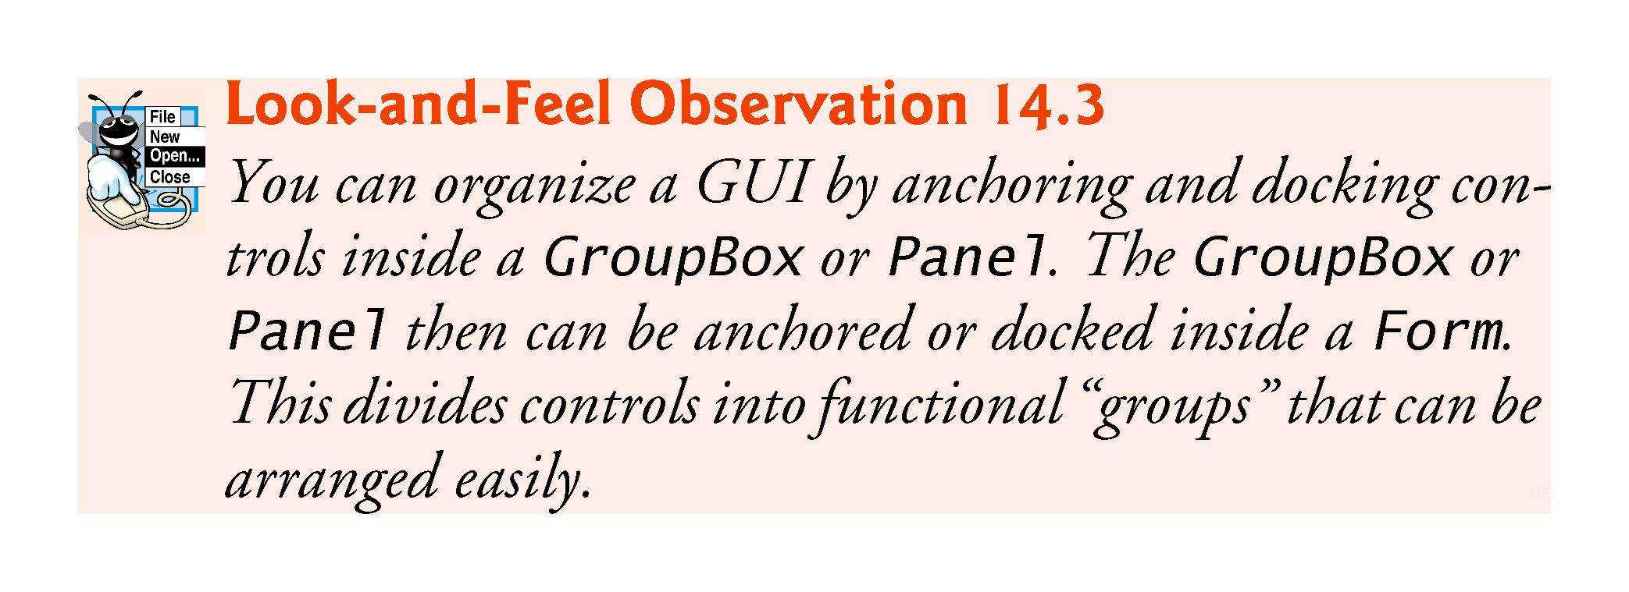

Slide 66
14.6 GroupBoxes and Panels (Cont.)
To create a GroupBox or Panel, drag its icon from the Toolbox onto a Form.
Then, drag new controls from the Toolbox directly into the GroupBox or Panel.
To enable the scrollbars, set the Panel’s AutoScroll property to true.
If the Panel cannot display all of its controls, scrollbars appear (Fig. 14.23).

Slide 67
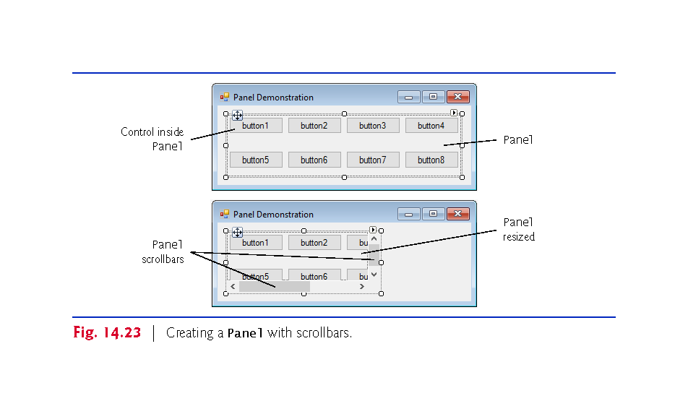

Slide 68
14.6 GroupBoxes and Panels (Cont.)
The program in Fig. 14.24 uses a GroupBox and a Panel to arrange Buttons.

Slide 69
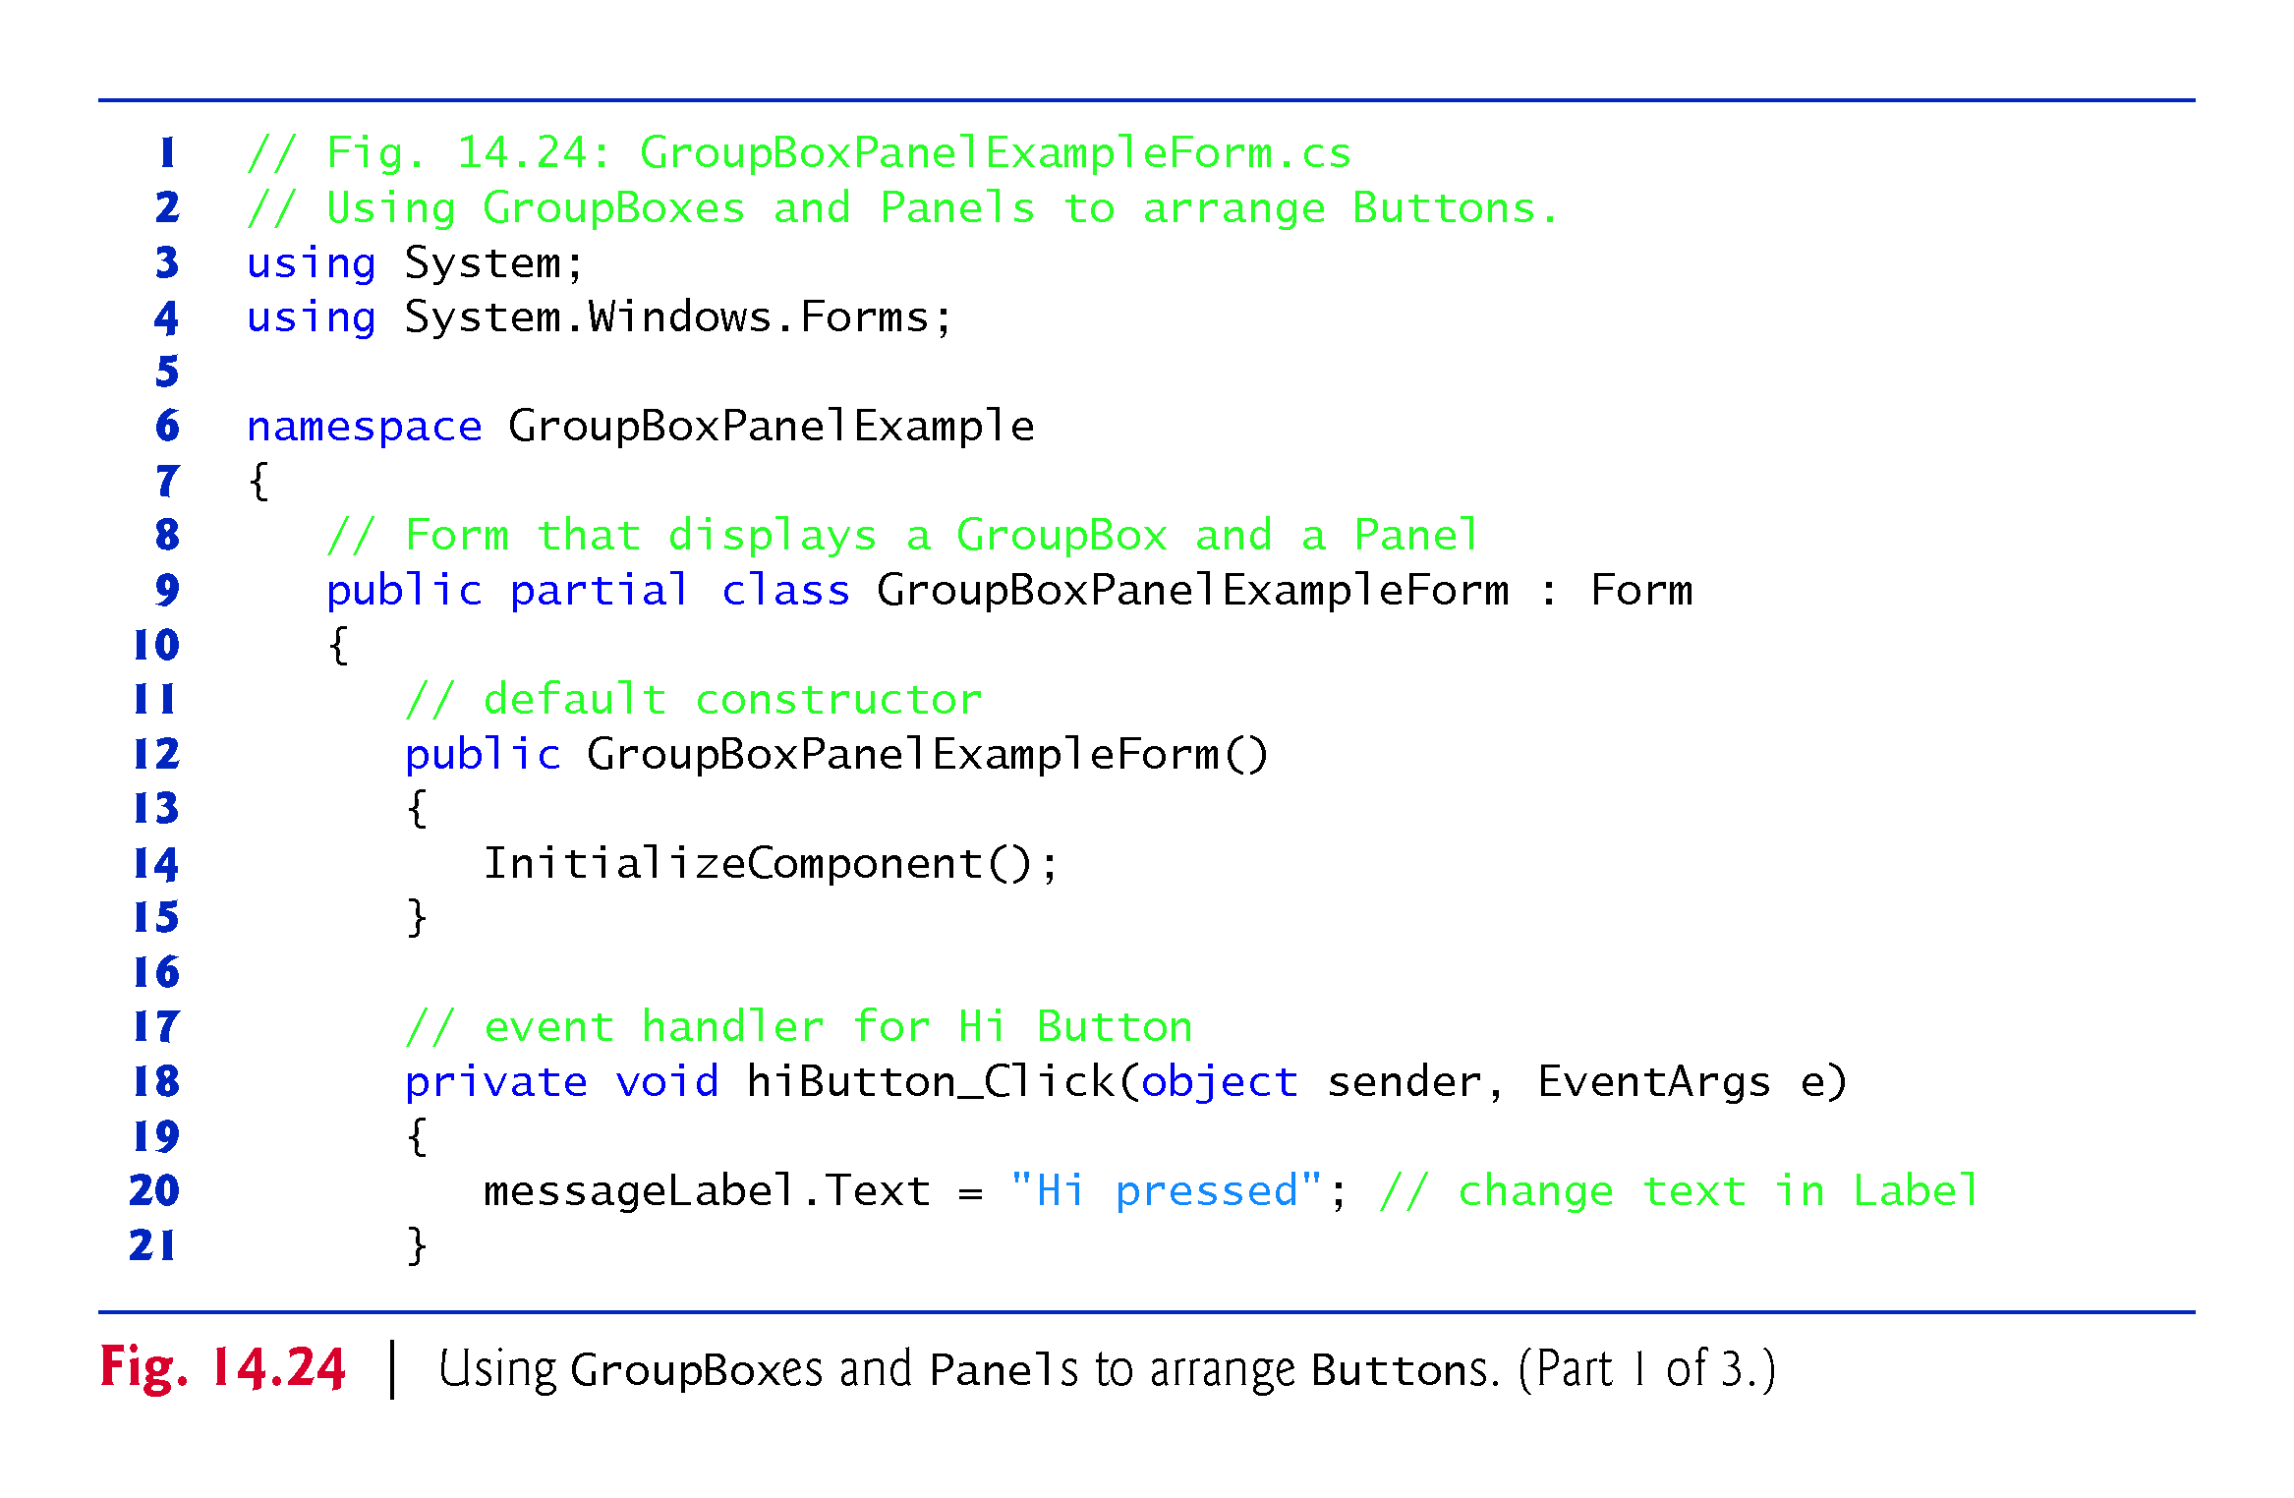

Slide 70
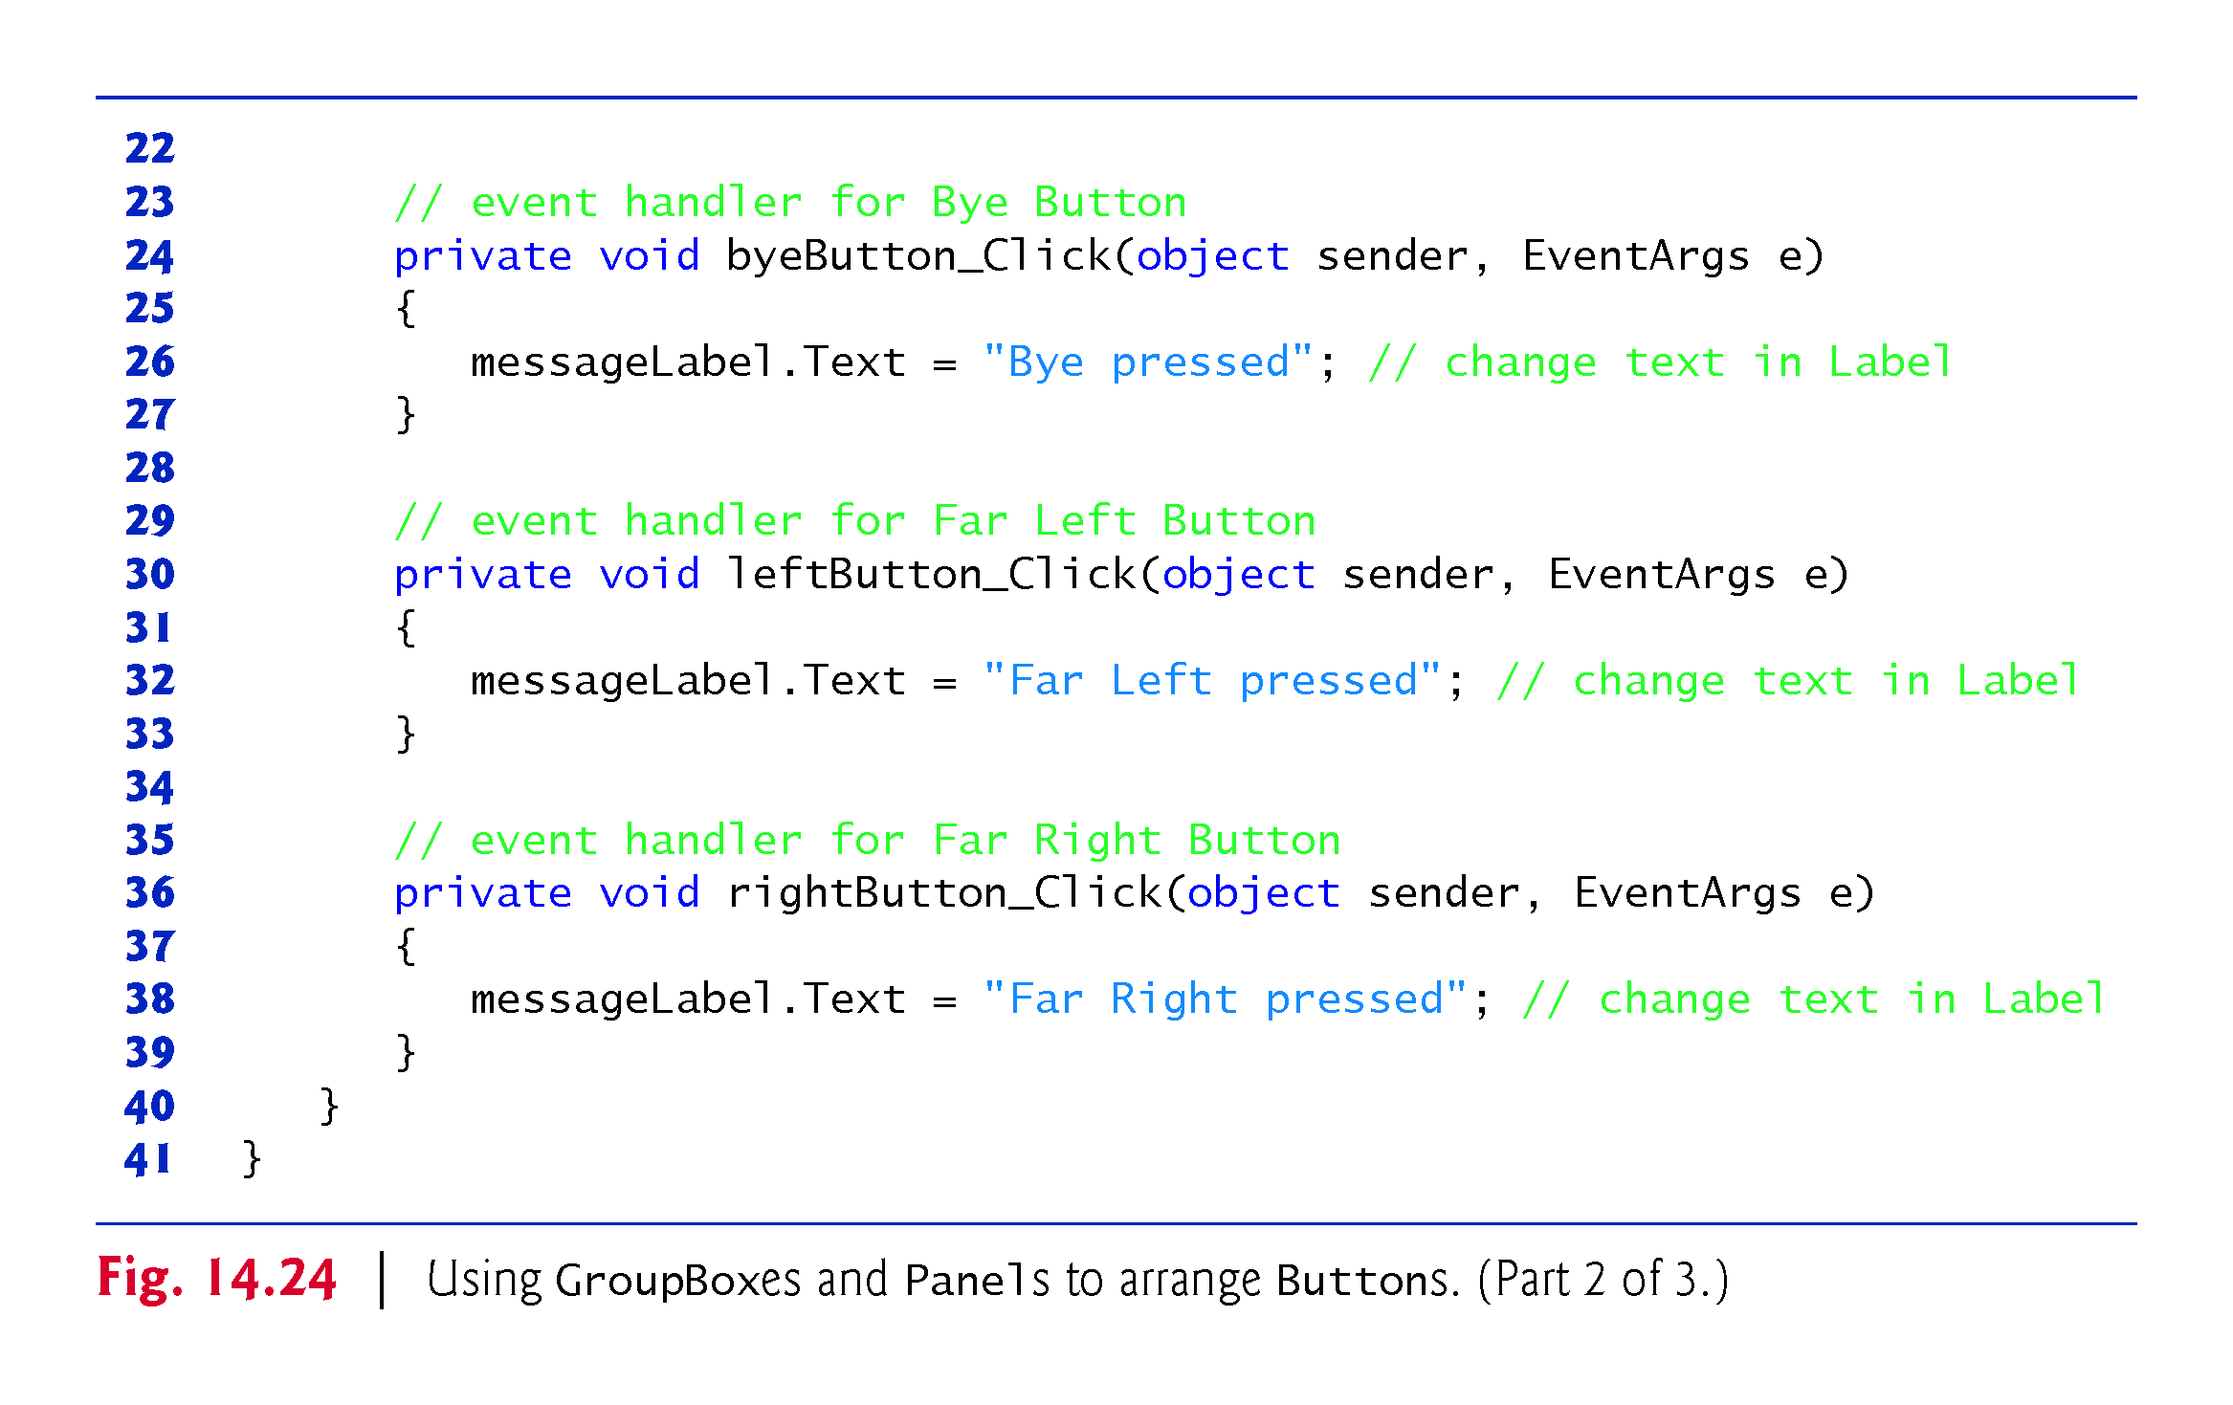

Slide 71
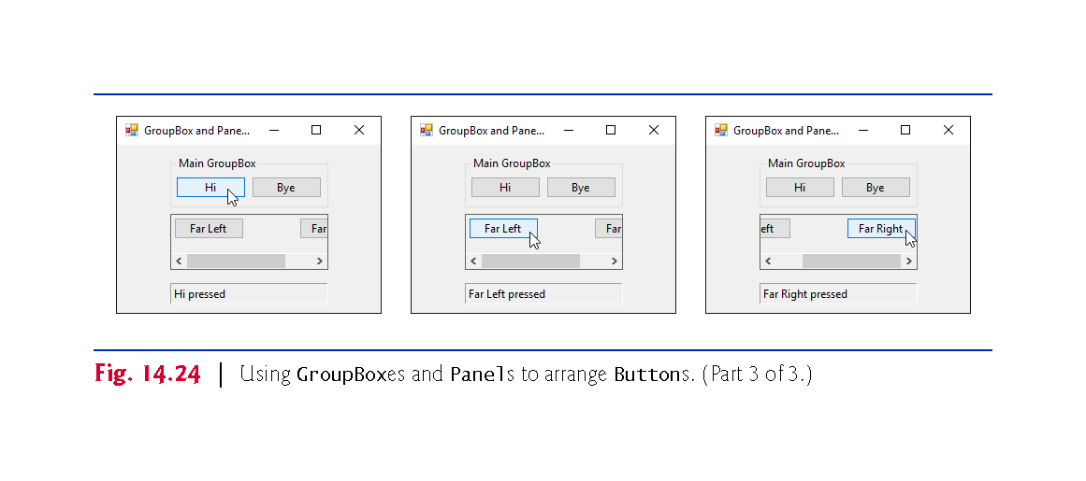

Slide 72
14.7 CheckBoxes and RadioButtons
CheckBoxes
A CheckBox is a small square that either is blank or contains a check mark.
You can also configure a CheckBox to toggle between three states by setting its Three­State property to True.
Any number of CheckBoxes can be selected at a time.

Slide 73
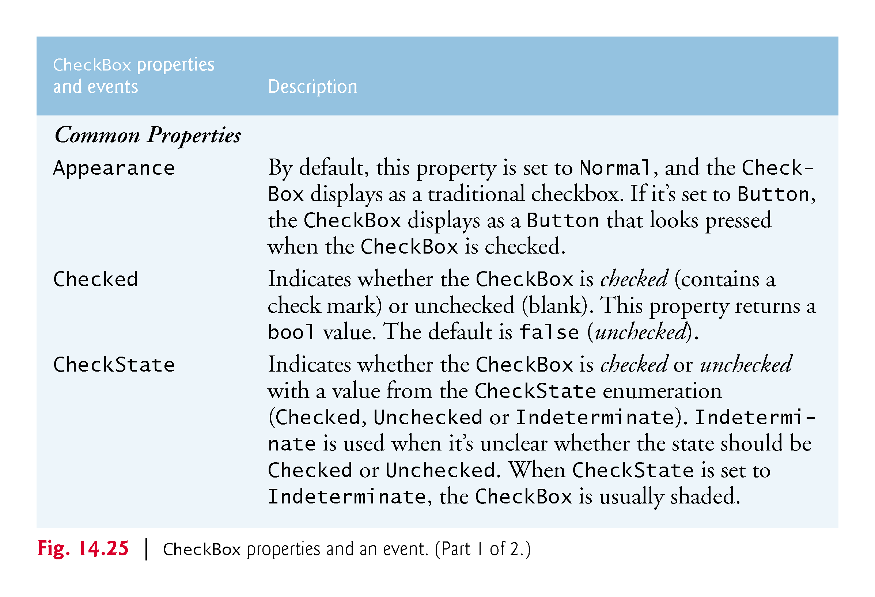

Slide 74
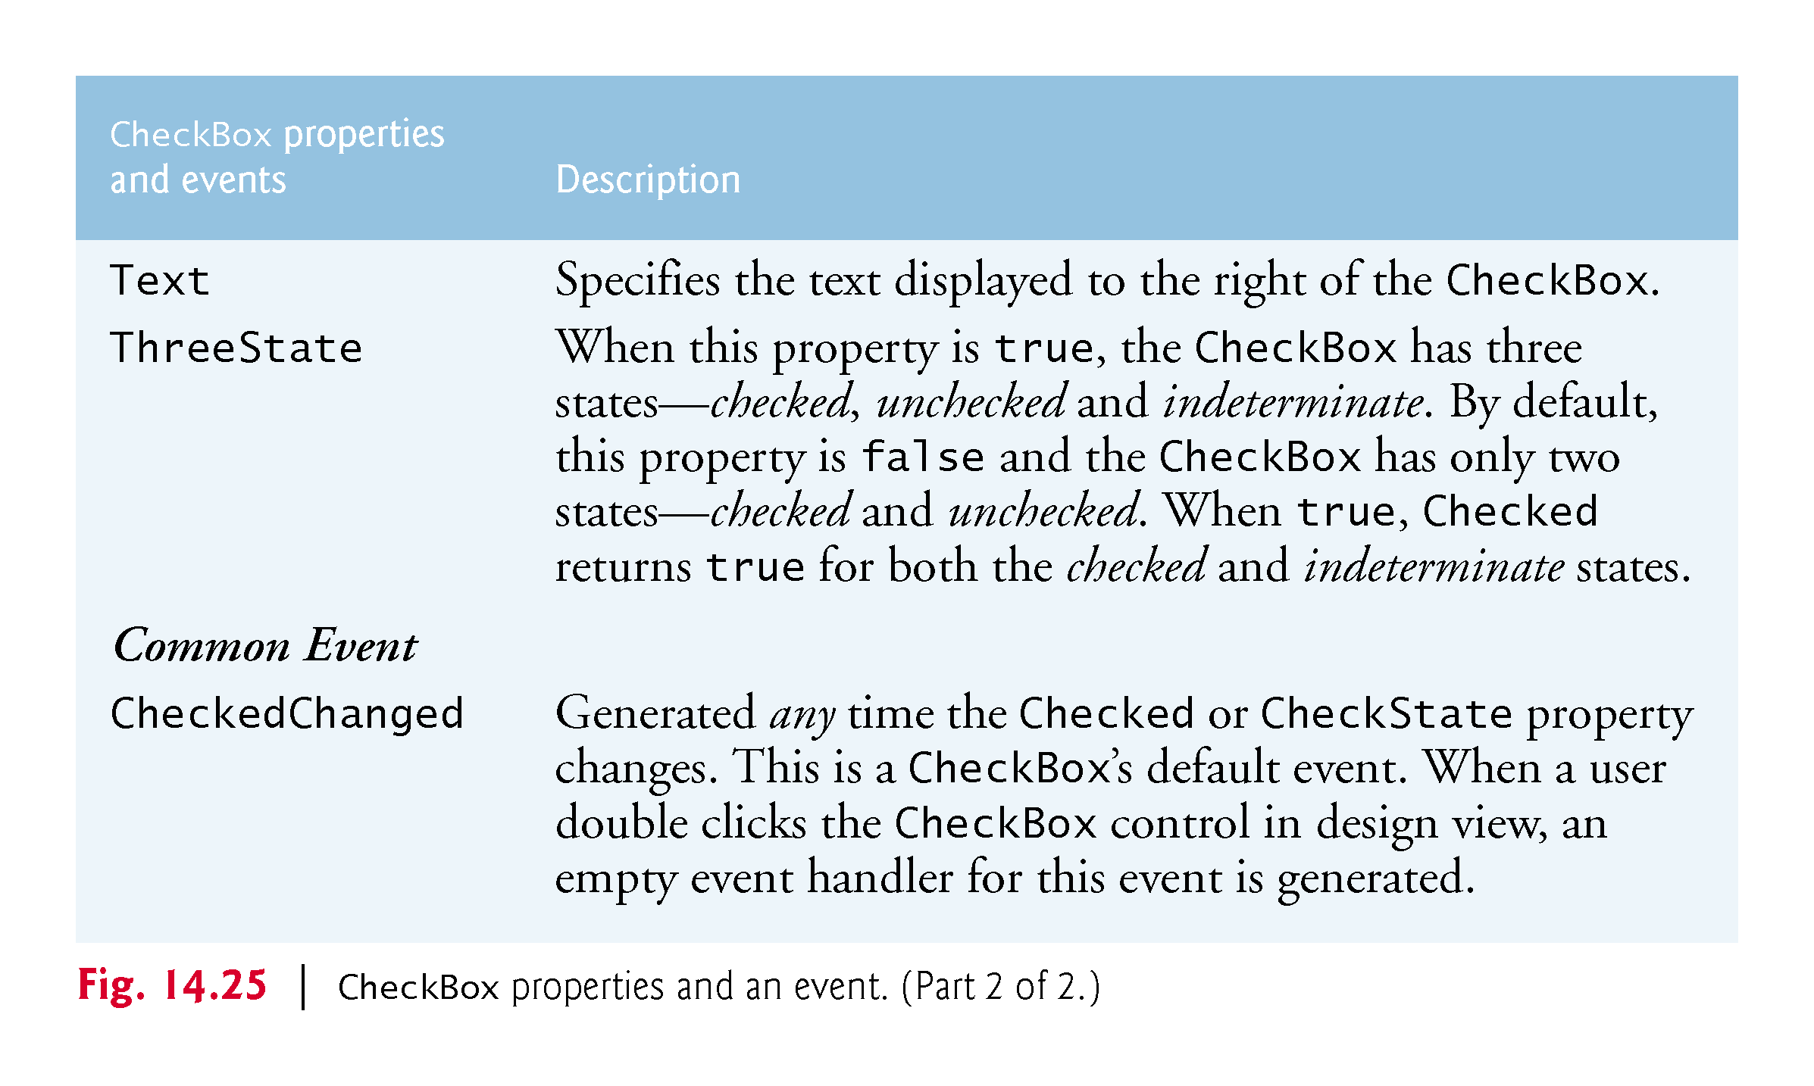

Slide 75
14.7 CheckBoxes and RadioButtons (cont.)
The program in Fig. 14.26 allows the user to select CheckBoxes to change a Label’s font style.

Slide 76
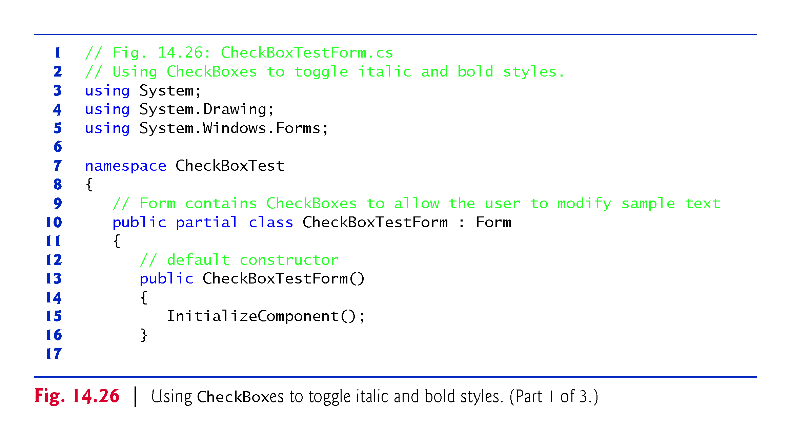

Slide 77
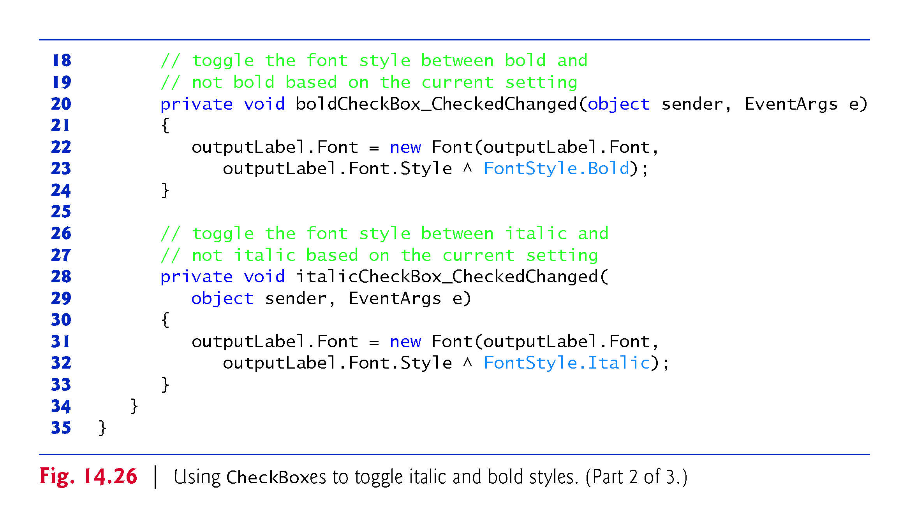

Slide 78
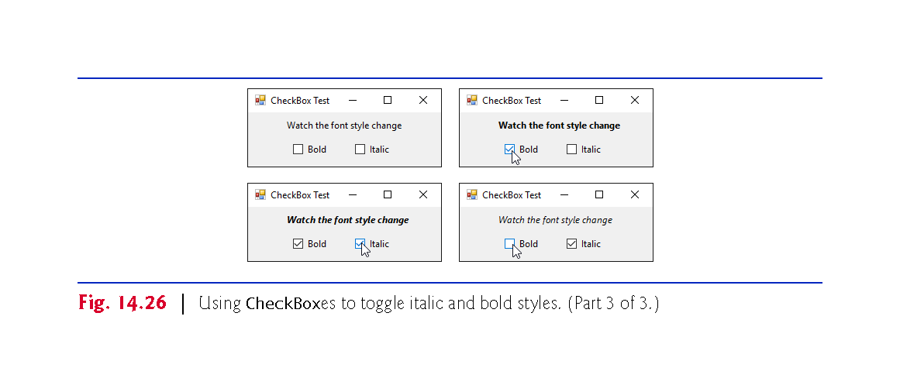

Slide 79
14.7 CheckBoxes and RadioButtons (Cont.)
To change the font style on a Label, you must set its Font property to a new Font object.
The Font constructor we used takes the current font and the new style as arguments.
Combining Font Styles with Bitwise Operators
Styles can be combined via bitwise operators—operators that perform manipulation on bits of information.
We needed to set the FontStyle so that the text appears in bold if it was not bold originally, and vice versa
The logical exclusive OR operator makes toggling the text style simple.

Slide 80
14.7 CheckBoxes and RadioButtons (Cont.)
RadioButtons
Radio buttons are similar to CheckBoxes in that they also have two states—selected and not selected.
RadioButtons normally appear as a group, in which only one RadioButton can be selected at a time.
All RadioButtons added to a container become part of the same group.

Slide 81
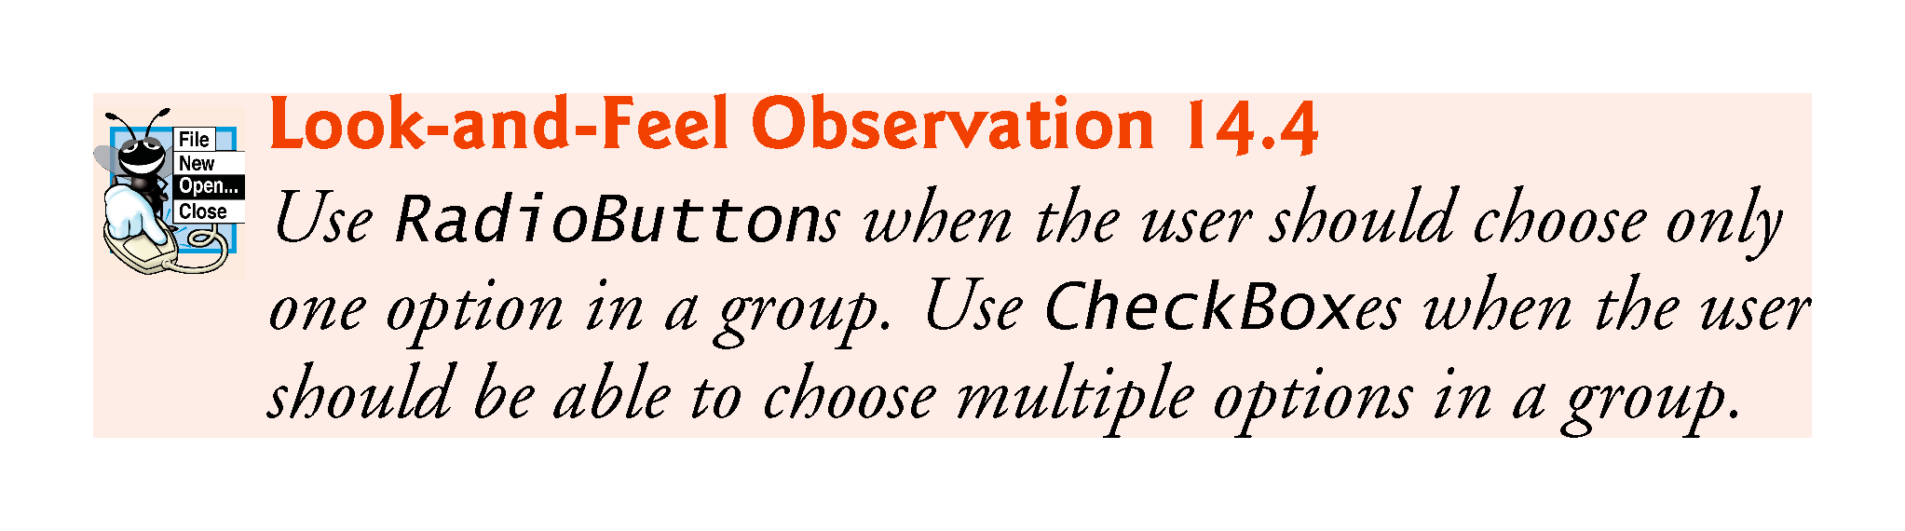

Slide 82
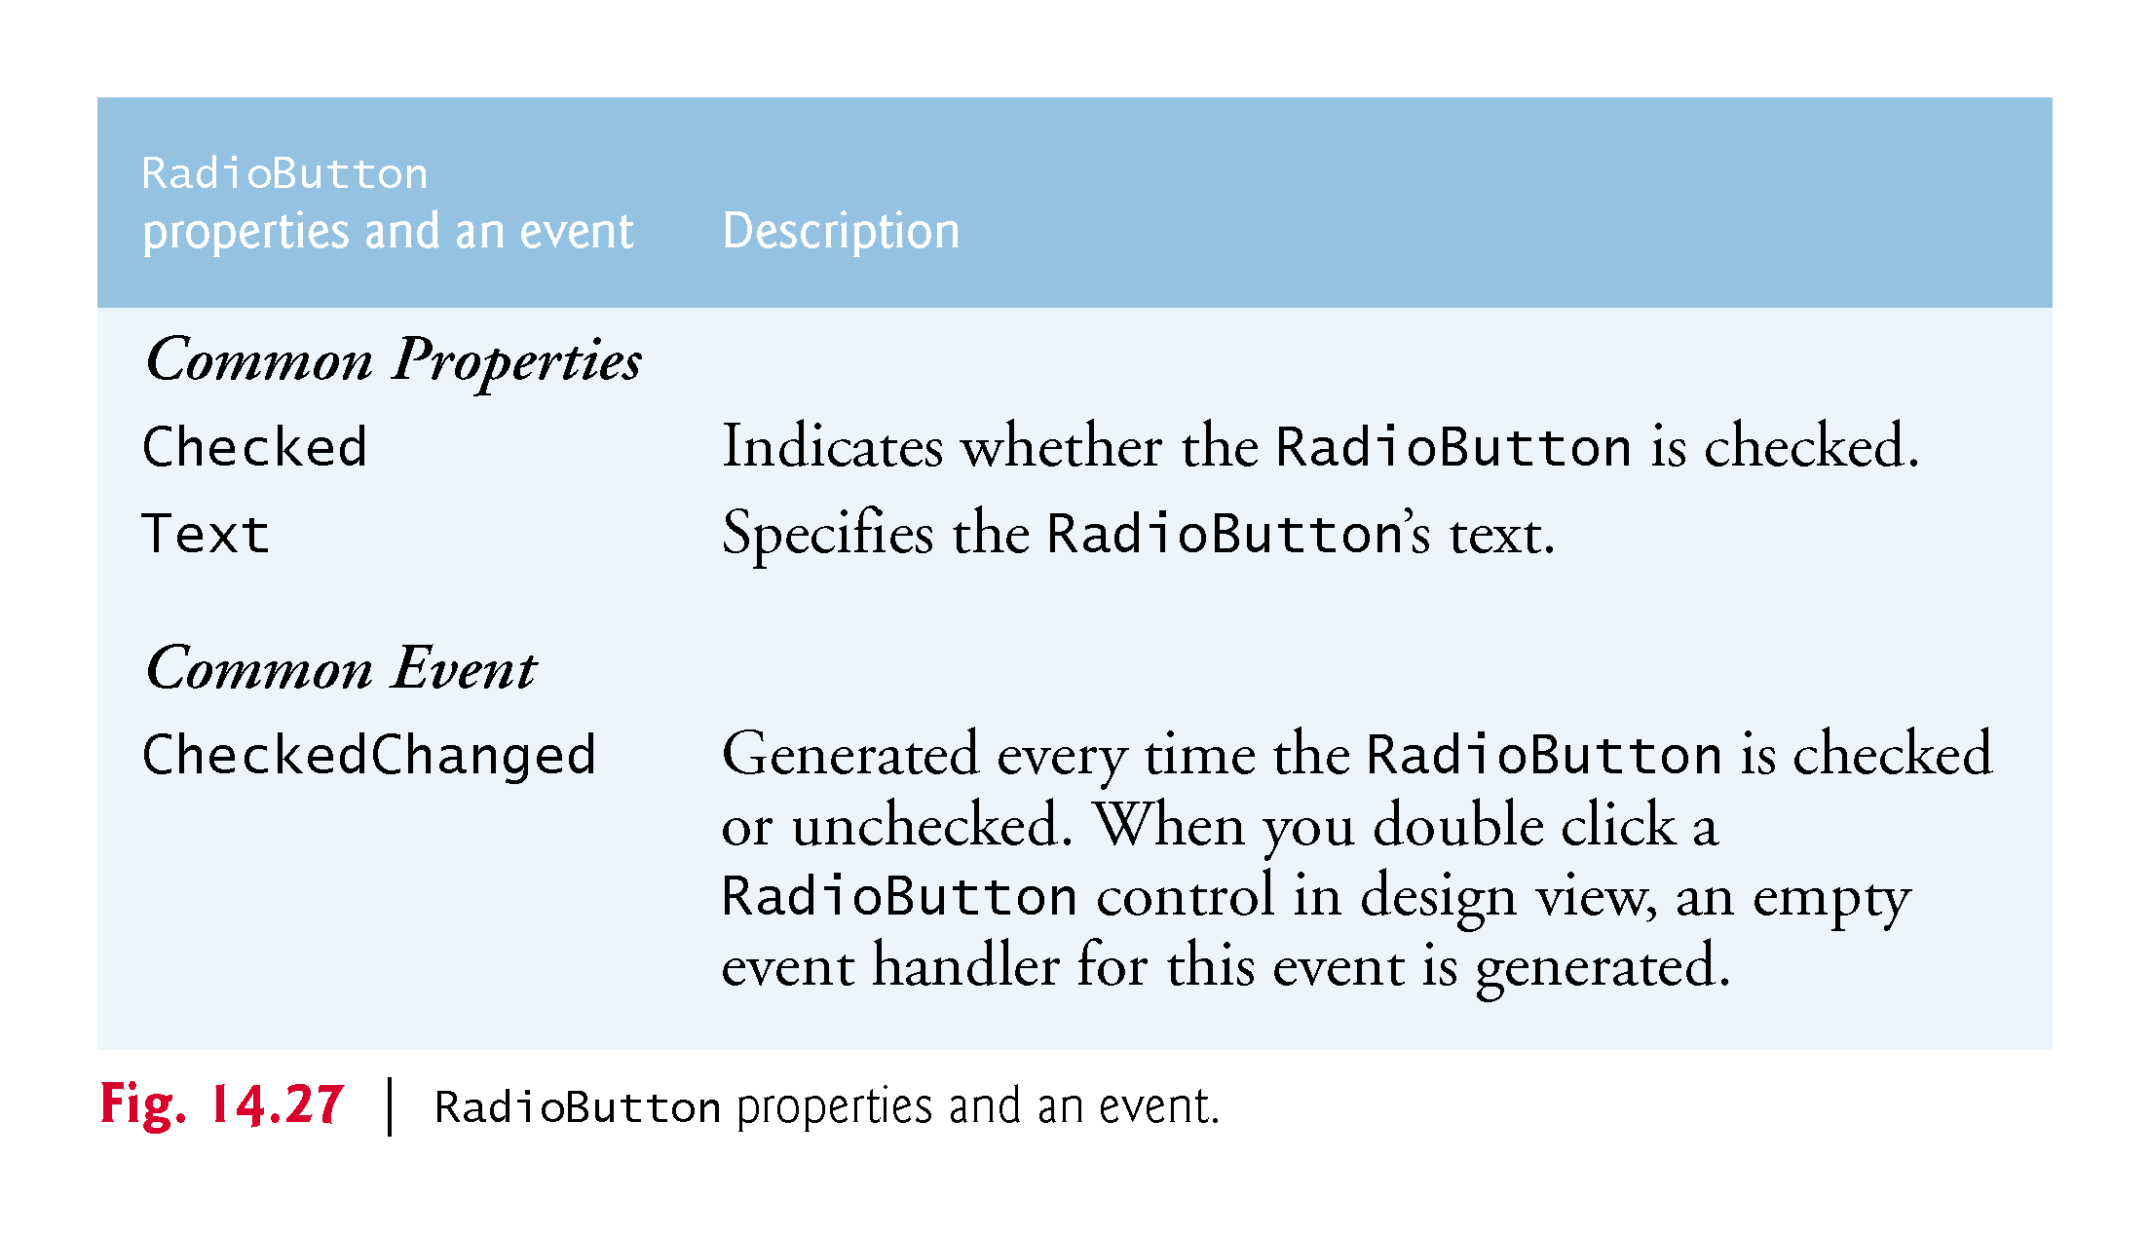

Slide 83
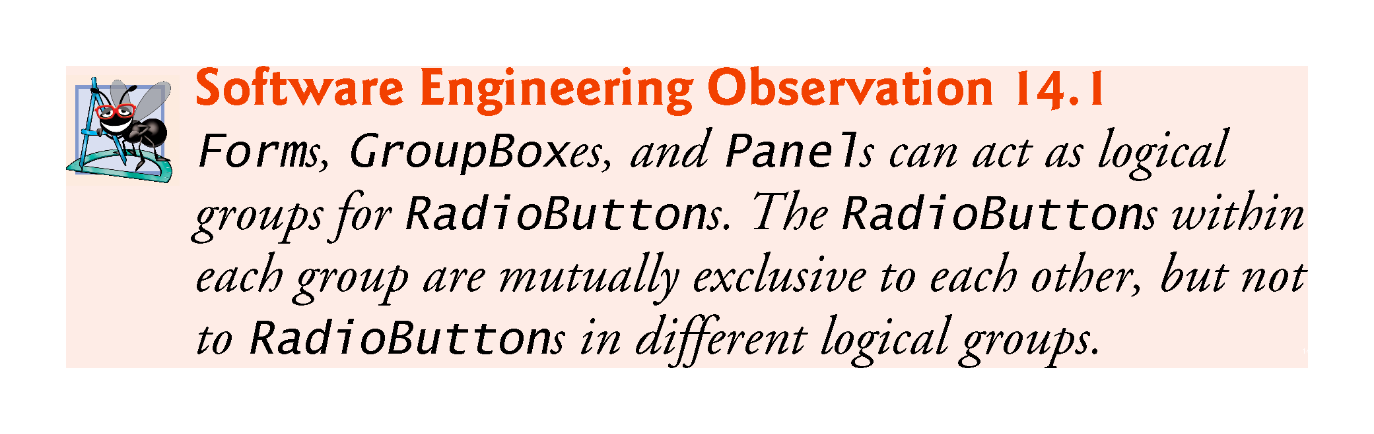

Slide 84
14.7 CheckBoxes and RadioButtons (Cont.)
The program in Fig. 14.28 uses RadioButtons to enable users to select options for a MessageBox.

Slide 85
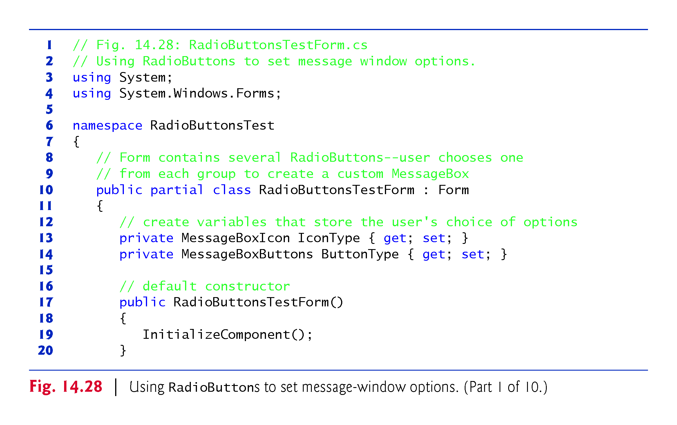

Slide 86
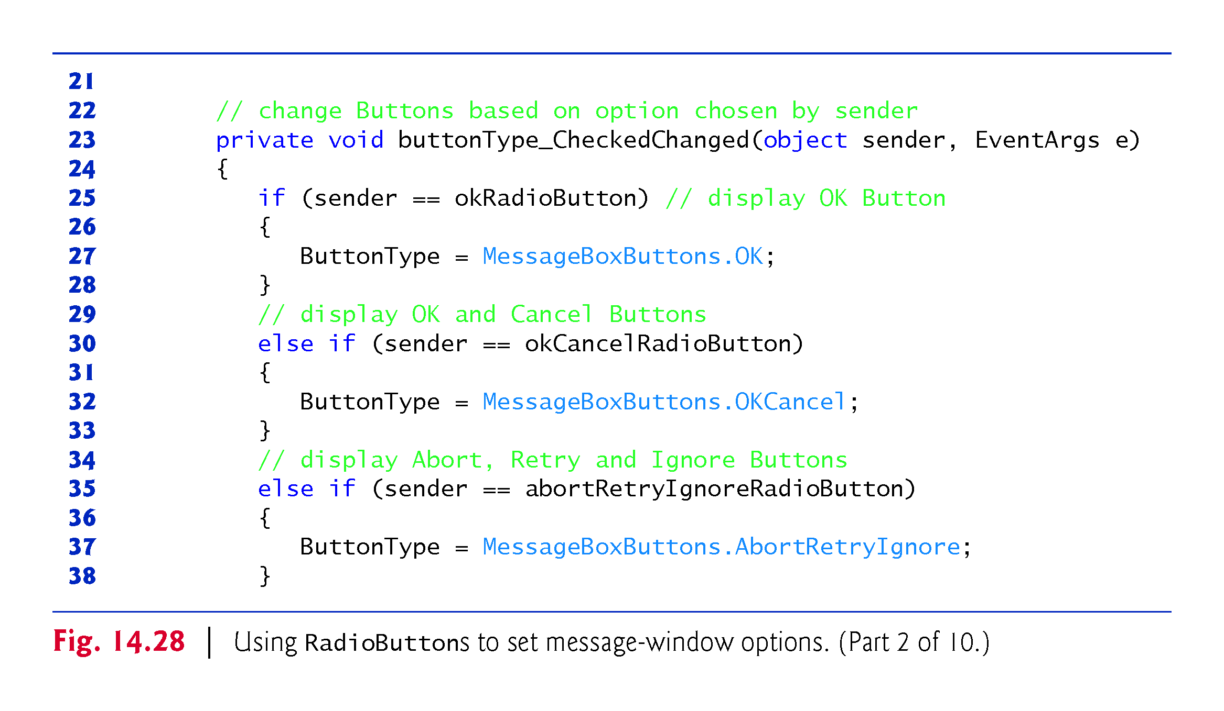

Slide 87


Slide 88


Slide 89


Slide 90


Slide 91


Slide 92


Slide 93


Slide 94


Slide 95
14.8 PictureBoxes
A PictureBox displays an image.
Figure 14.29 describes common PictureBox properties and a common event.

Slide 96


Slide 97


Slide 98
14.8 PictureBoxes
Figure 14.30 uses a PictureBox to display bitmap images.

Slide 99


Slide 100


Slide 101


Slide 102
14.8 PictureBoxes (Cont.)
Using Resources Programmatically
Embedding the images in the app prevents problems of using several separate files.
To add a resource:
Double click the project’s Properties node in the Solution Explorer.
Click the Resources tab.
At the top of the Resources tab click the down arrow next to the Add Resource button and select Add Existing File…
Locate the files you wish to add and click the Open button.
Save your project.

Slide 103
14.8 PictureBoxes (Cont.)
A project’s resources are stored in its Resources class.
Its ResourceManager object allows interacting with the resources programmatically.
To access an image, use the method GetObject, which takes as an argument the resource name as it appears in the Resources tab.
The Resources class also provides direct access with expressions of the form Resources.resourceName.

Slide 104
14.9 ToolTips
Recall that tool tips are the helpful text that appears when the mouse hovers over an item in a GUI.
Figure 14.31 describes common properties and a common event of class ToolTip.

Slide 105


Slide 106
14.9 ToolTips
A ToolTip component appears in the component tray—the region below the Form in Design mode.
A ToolTip on property for each ToolTip component appears in the Properties window for the Form’s other controls.
Figure 14.32 demonstrates the ToolTip component.

Slide 107


Slide 108
14.9 ToolTips (Cont.)
Figure 14.33 shows the ToolTip in the component tray.
We set the tool tip text for the first Label to "First Label" and the tool tip text for the second Label to "Second Label".

Slide 109


Slide 110
14.9 ToolTips (Cont.)
Figure 14.34 demonstrates setting the tool-tip text for the first Label.

Slide 111


Slide 112
14.10 NumericUpDown Control (cont.)
Restricting a user’s input choices to a specific range of numeric values can be done with a NumericUpDown control.
A user can type numeric values into this control or click up and down arrows.
Figure 14.35 describes common NumericUpDown properties and an event.

Slide 113


Slide 114


Slide 115
14.10 NumericUpDown Control
Figure 14.36 demonstrates a NumericUpDown control in a GUI app that calculates interest rate.
For the NumericUpDown control, we set the Minimum to 1 and the Maximum to 10.
We set the NumericUpDown’s ReadOnly property to true to indicate that the user cannot type a number into the control.

Slide 116


Slide 117


Slide 118


Slide 119
14.11 Mouse-Event Handling
Mouse events are generated when the user interacts with a control via the mouse.
Information about the event is passed through a MouseEvent­Args object, and the delegate type is Mouse­EventHandler.
MouseEventArgs x- and y-coordinates are relative to the control that generated the event.
Several common mouse events and event arguments are described in Figure 14.37.

Slide 120


Slide 121


Slide 122
14.11 Mouse-Event Handling
Figure 14.38 uses mouse events to draw on a Form.

Slide 123


Slide 124


Slide 125


Slide 126


Slide 127
14.11 Mouse-Event Handling (Cont.)
Recall from Chapter 13 that the using statement automatically calls Dispose on the object that was created in the parentheses following keyword using.
This is important because Graphics objects are a limited resource.
Calling Dispose on a Graphics object ensures that its resources are returned to the system for reuse.

Slide 128
14.12 Keyboard-Event Handling
There are three key events:
The KeyPress event occurs when the user presses a key that represents an ASCII character.
The KeyPress event does not indicate whether modifier keys (e.g., Shift, Alt and Ctrl) were pressed; if this information is important, the KeyUp or KeyDown events can be used.

Slide 129


Slide 130


Slide 131


Slide 132


Slide 133


Slide 134


Slide 135


